Slide 1

TECHNICAL INTRODUCTION TO PYTHON

Slide 2
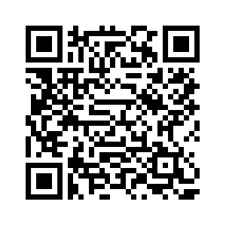
Please use this QR code to sign in

Slide 3


TODAY’S WORKSHOP
Install Tools
Jupyter Notebooks
Virtual Environments
Learn to use Jupyter notebook cells
Distinguish command mode and edit mode
Distinguish code cells and markdown cells
Open and shut down notebooks
Use Python to open a text file and load the text
Learn about standard and 3rd party libraries
Learn about versioning and potential problems with versioning and code obsoletion
Learn to create and manage virtual environments in Jupyter
Mac users will install Xcode command line tools.
Sign up for GitHub
Install Anaconda Navigator toolkit
Activate Jupyter Notebook

Slide 4
01
INSTALLING TOOLS

Slide 5

ANACONDA NAVIGATOR
Anaconda Navigator is a bundle of tools that are commonly used in data science. It includes Python, Jupyter Notebooks, and several Integrated Development Environments (IDEs) that are used to program in Python.

Slide 6
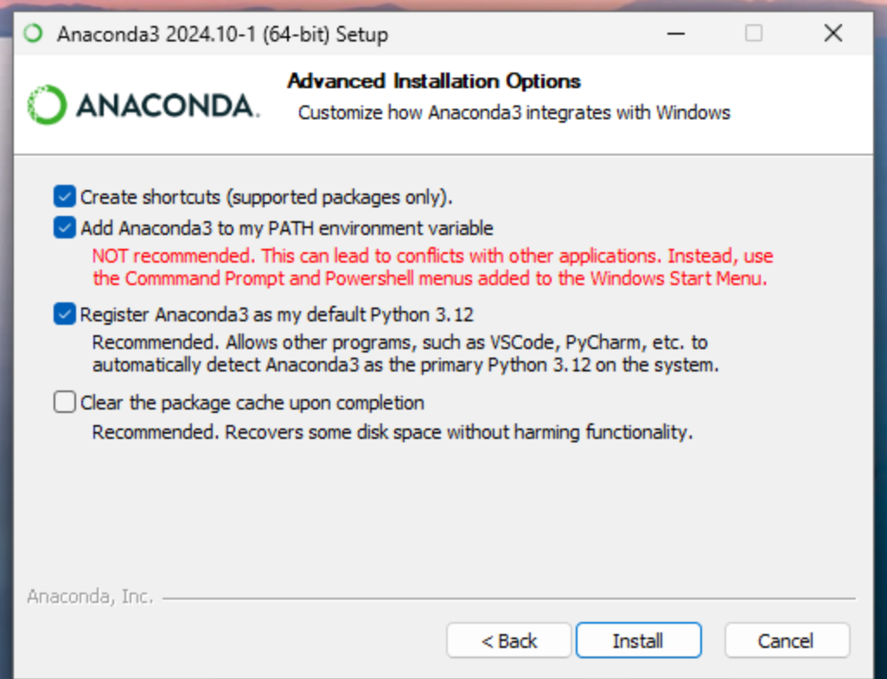
INSTALLING ANACONDA NAVIGATOR
Go to anaconda.com
Select Products from the menu
Select Navigator
Find the “Download Now” button
You can click “Skip Registration” or provide your email if you wish
Select the correct Installer for your system
On a Mac, you may check the Apple menu -> About this Mac -> Processor to see if you have an older Intel processor or an Apple chip. Select the Graphical Installer.
Be careful not to install Miniconda instead of Anaconda by accident. This will happen if you scroll down too quickly on the Anaconda Navigator download page.
On Windows, there is a different install process, and it is important to check one of the boxes.

Slide 7
INSTALLING ANACONDA NAVIGATOR
Yes, I know it says “NOT recommended”. But we must check the box that says “Add Anaconda3 to my PATH environment variable, or it will be challenging to install virtual environments from our notebooks later in this workshop.
When you are done with the installation, then Windows will ask if you want to “Launch Anaconda Navigator” and “Getting Started with Anaconda Distribution”, uncheck both boxes.

Slide 8
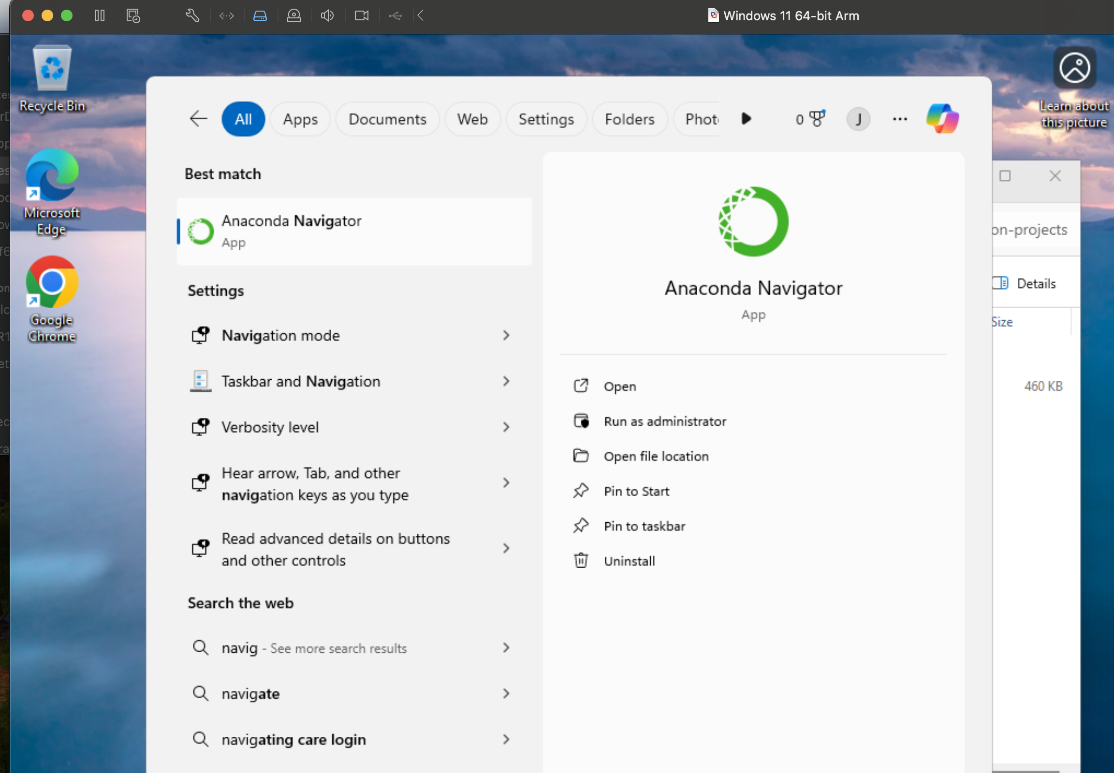
INSTALLING ANACONDA NAVIGATOR
If using Windows, search for Anaconda Navigator in your search bar, right-click and select “Run as administrator”. This will allow you to open a terminal window from within your notebook, which will make it much easier to install and run virtual environments within your Jupyter Notebook programming environment.

Slide 9
INSTALLING ANACONDA NAVIGATOR
Anaconda will generally ask if you want to you want to update Navigator. This process can be a bit glitchy, so I recommend waiting to do that at a later time.
Anaconda will also ask you to sign in for AI coding help. It can be quite insistent about this. Do not sign up for AI coding help.

Slide 10
02
USING JUPYTER NOTEBOOKS

Slide 11
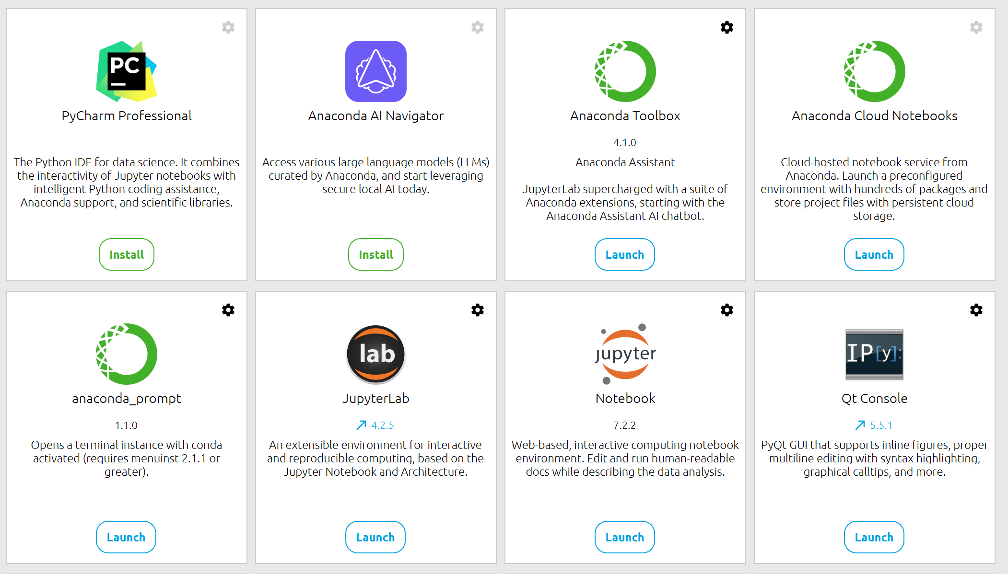
NOW WE HAVE JUPYTER NOTEBOOK
A Notebook is a kind of development environment that allows you to mix comments, notes, and instructions with code samples, and at the same time to run code and see the results.
Jupyter Notebooks can run in a browser with minimal to no command line usage.
Note we are using Jupyter Notebook, not Jupyter Lab.

Slide 12
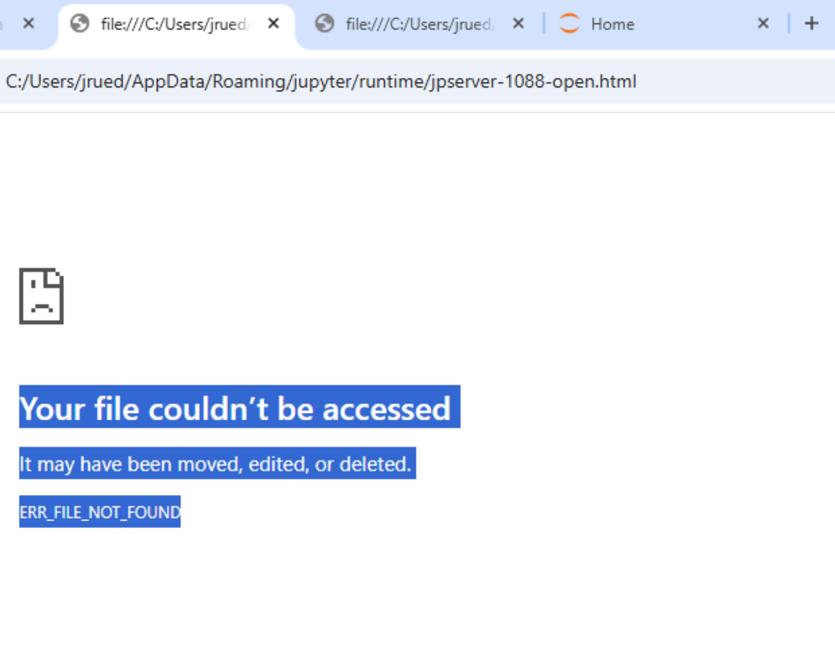
PROBLEMS IN WINDOWS
Sometimes you may get this problem in Windows.
In this case, use your search box to find Anaconda Prompt. Right-click and run it as administrator.

Slide 13
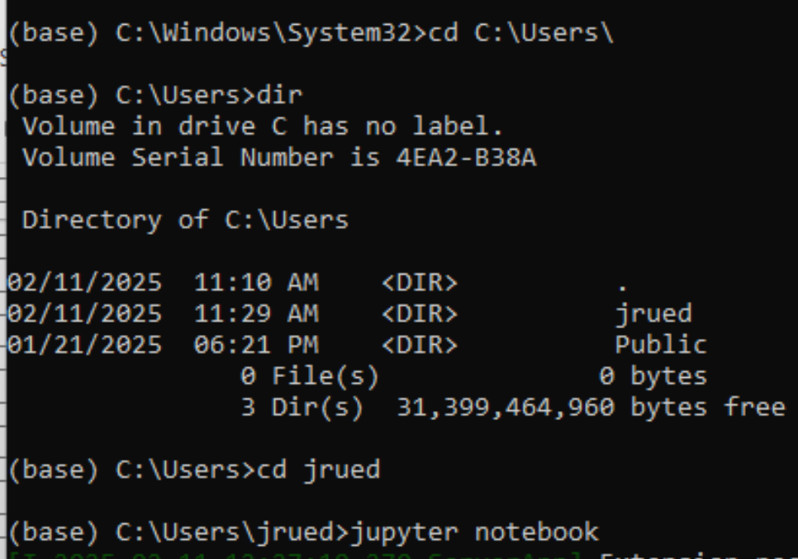
PROBLEMS IN WINDOWS
In the Anaconda Prompt, navigate to your home directory by typing cd C:\Users\ first, then type dir to find the name of your home directory, then type cd nameOfYourHome, for example in my case cd jrued

Slide 14
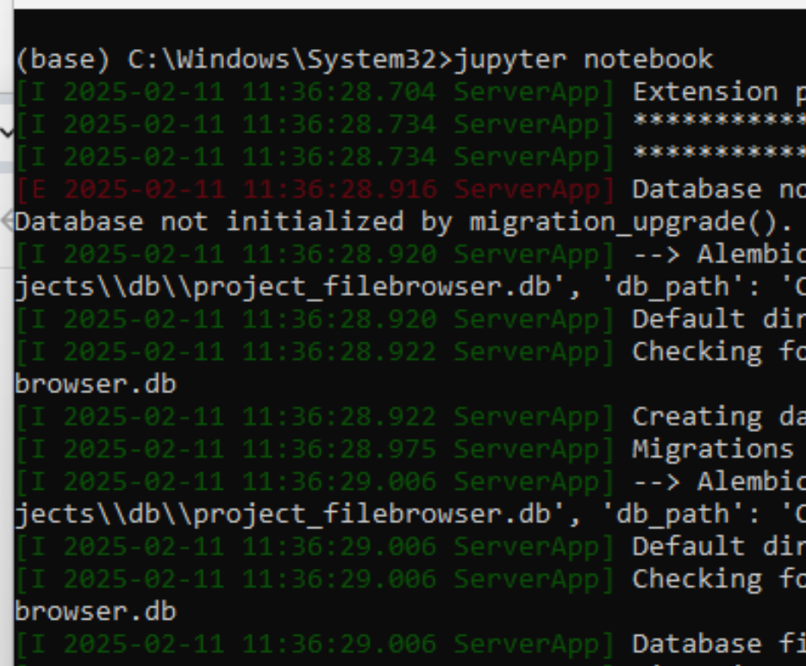
PROBLEMS IN WINDOWS
In the Anaconda Prompt, after you have navigated to your home folder, type jupyter notebook.

Slide 15
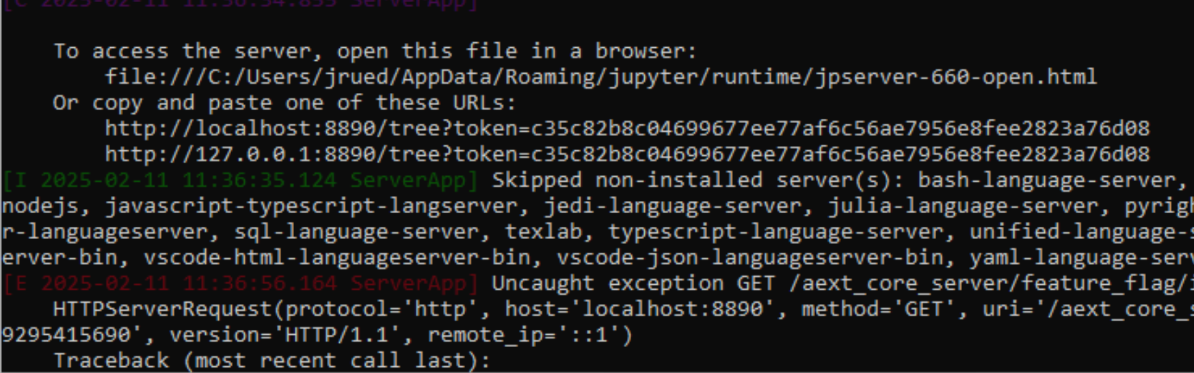
PROBLEMS IN WINDOWS
Find where it says “copy and paste one of these URLs”. Copy one of the URLs and paste it into your browser. In the future, you should be able to open directly from the Anaconda Navigator graphical prompt.

Slide 16
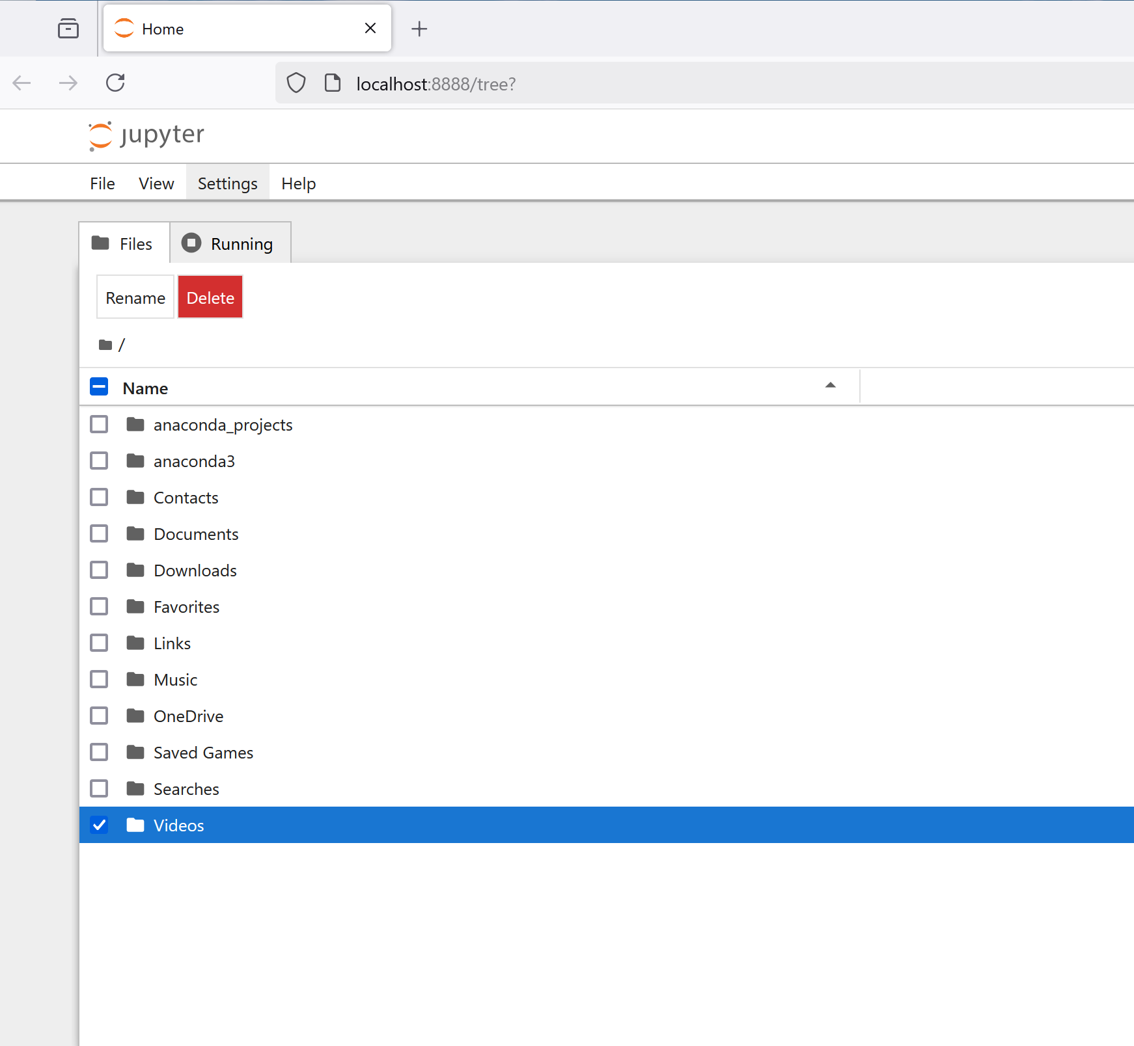
JUPYTER NOTEBOOK INTERFACE
A browser window will open in your default browser. In that window you will see the folders at the top level of your computer.
If you see a prompt to enable the “Anaconda Assistant”, close that tab.
In Mac you will see a Terminal window open. You can mostly ignore this for now.

Slide 17
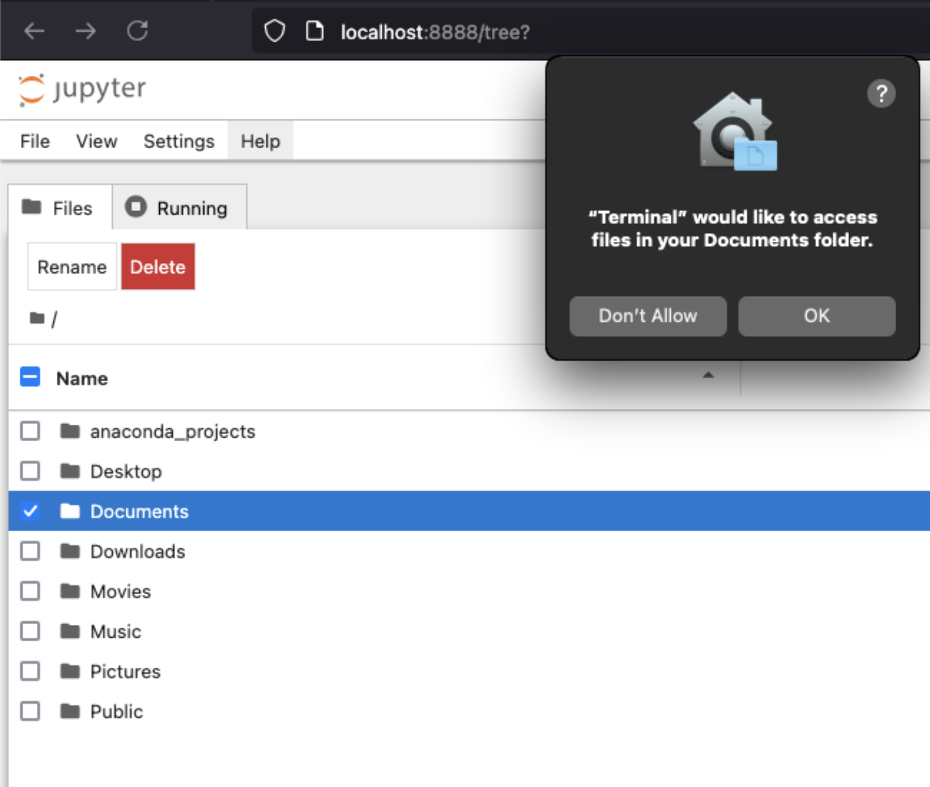
AUTHORIZE YOUR TERMINAL
The Jupyter interface acts as a normal file navigator, but behind the scenes there is server code running in the Terminal application. The Terminal server sends and receives data from your browser, and acts to mediate the flow of information between your server and the Python kernel. On a Mac, you will need to do a one-time authorization for the Terminal to access your Documents folder.

Slide 18
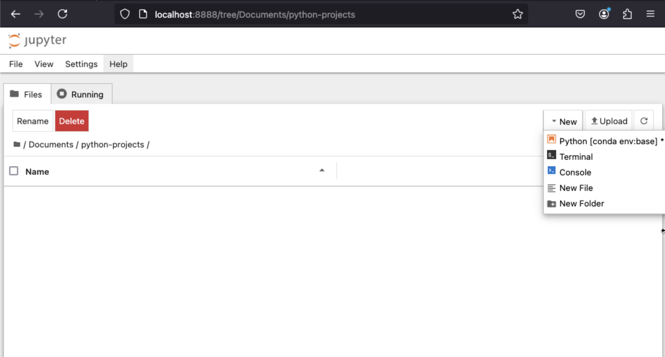
CREATE A NOTEBOOK
Create a folder to hold your Python projects, then navigate into that folder.
Select new, and Python. Note the cryptic text “conda env:base” next to it. We will see what this means later in the workshop.
When you click on Python, a new Notebook called “untitled.inpyb” will be created. Note the .inpyb file format.

Slide 19
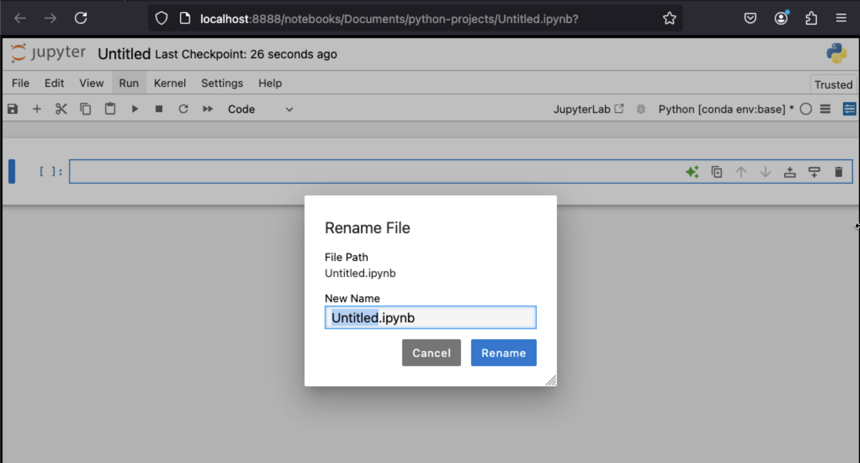
RENAME THE FILE

Slide 20
LEARNING ABOUT NOTEBOOKS
Get the text file from https://github.com/jruedas1/cedish-python-workshop. If you do not already have a GitHub account, make one now. It is free and this is the world’s foremost site for sharing open-source code.
Download the text file or obtain another text file from Project Gutenberg: https://www.gutenberg.org/
Writing code in a cell
Command mode and edit mode
Running code in a cell.
Locating keyboard shortcuts
Markdown cells
Quick intro to Markdown: https://www.markdownguide.org/cheat-sheet/#basic-syntax
Shutting down a notebook
Restarting the kernel
Shutting down the Jupyter Notebook kernel completely
Reopening a notebook
Downloading and opening someone else’s notebook. Here’s a collection of notebooks for digital humanities: https://github.com/quinnanya/dh-jupyter

Slide 21
JUPYTER NOTEBOOK SHORTCUTS
Enter Command Mode: ESC
Enter Edit Mode; RETURN / ENTER (can also enter Edit Mode by clicking in cell)
Create new cell Above: A
Create new cell Below: B
Run code: CMD + Enter / Ctrl + Enter
Run code and advance: Option + Enter / Alt + Enter
Switch cells: in Command Mode, up and down arrows
Delete cell: DD
Switch cell type: in Command Mode, Y for Code, M for Markdown

Slide 22




NOTEBOOK ARCHITECTURE
Notebook Server
User’s browser
Python Kernel
Notebook File (.ipynb)

Slide 23
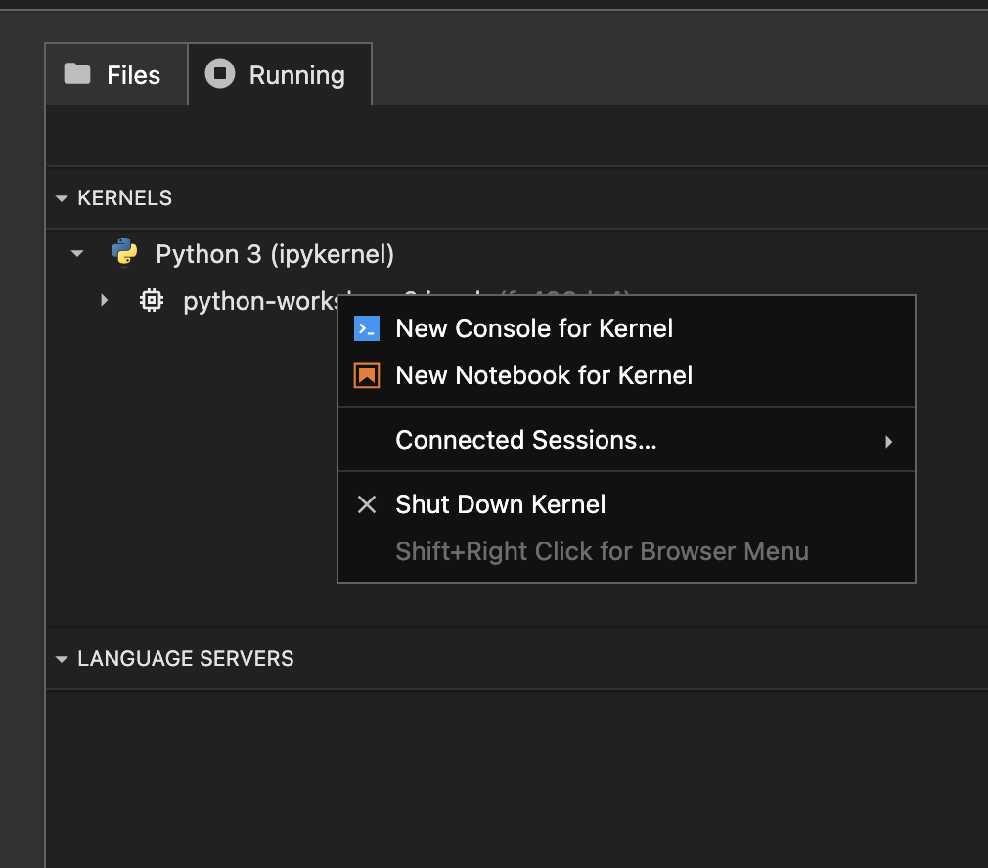
SHUTTING DOWN A NOTEBOOK
The Notebook involves a Python kernel and a Notebook server. The browser is just the interface to these underlying programs. Closing the page or the browser will not shut down the notebook. The process will still run in the background.
Instead, go to the main Notebook interface, select the “Running” tab, select the notebook, right click, and select shut down kernel.
Alternatively, you may “Shut Down All” on the top right hand side.

Slide 24
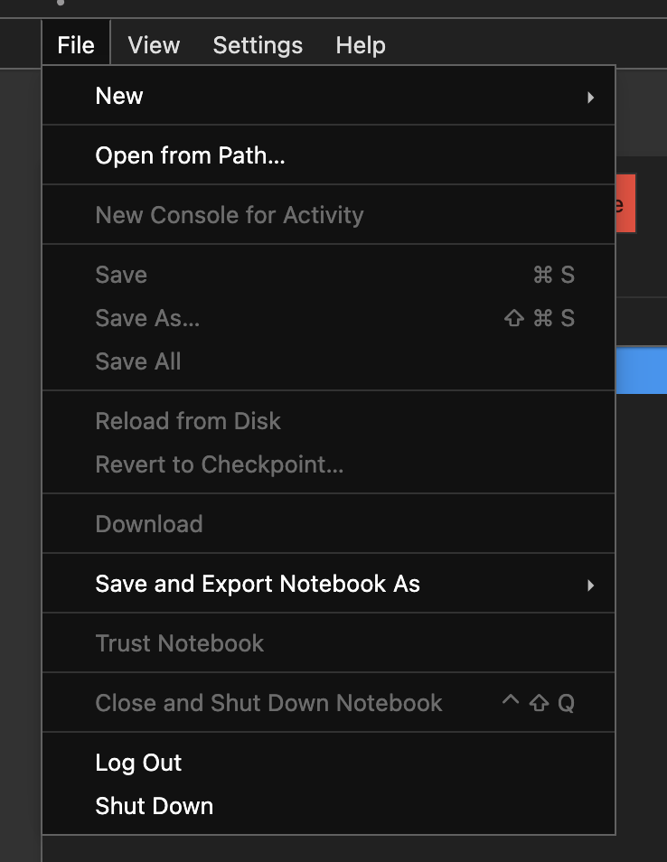
SHUTTING DOWN A NOTEBOOK – PART 2
Even after you shut down a kernel, the server is still running. To shut down the server, select File -> Shut Down.
New Notebooks will still open if you have old ones running in the background, but it does consume your computer’s memory and processing, so try to be diligent about shutting down kernels and servers.

Slide 25
OPENING AND CLOSING NOTEBOOKS FINDING USEFUL NOTEBOOKS ONLINE
To open up a closed notebook, just launch Jupyter Notebooks, navigate to the folder the notebook is in, and double-click on it, or right-click and select Open.
This applies also to finding and downloading other notebooks created and shared by other people. Here is a GitHub repo (repository) that lists useful digital humanities notebooks: https://github.com/quinnanya/dh-jupyter
You can also do a search for “Digital Humanities Jupyter Notebooks” to find many examples.
https://github.com/tomvannuenen/DIGHUM160/tree/main/notebooks
https://github.com/ds-modules/XENGLIS-31AC
https://github.com/mchesterkadwell/named-entity-recognition

Slide 26

SIGN UP FOR GITHUB
If you do not already have a GitHub account, it’s time to sign up for one. GitHub is the world’s foremost code-sharing platform. It is where I will share the slides, the Jupyter Notebook, and the text file for this workshop. GitHub is free. It is currently owned by Microsoft. This is also where you will find many useful notebooks shared by other people.
GitHub: https://github.com/

Slide 27
03
VIRTUAL ENVIRONMENTS

Slide 28
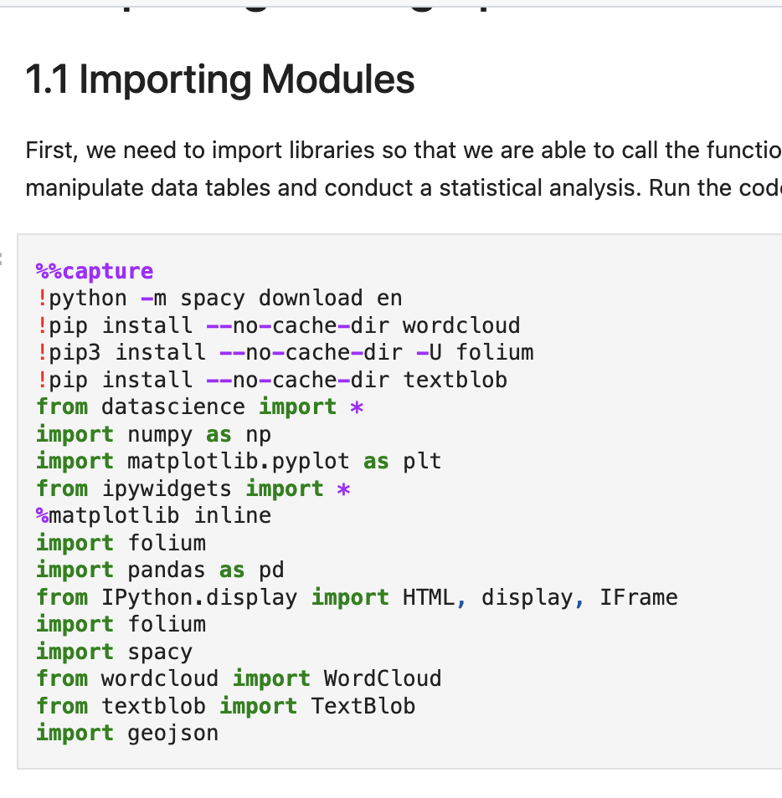
PIP AND LIBRARIES
If you look around online for useful Python code snippets, you will inevitably come across mention of pip, import, libraries, and even virtual environments. It is important to have a good idea of what these mean and how to manage libraries in Python. It is very useful to understand virtual environments and how to manage them, right from the start of your Python experience.

Slide 29
3RD PARTY LIBRARIES
When you install Python, you install what is known as the standard library. This is more than enough to do most basic programming tasks.
In order to do more specialized programming, such as text analysis or data visualization, it is often necessary to install a 3rd party library such as Spacy for natural language processing or Seaborn for data visualization.
3rd party libraries often rely on other 3rd party libraries.
3rd party libraries have versions that evolve over time and are compatible with specific versions of Python.
If you write code with a specific version of a library and of Python, a few years later, that same code might not work with a later version of Python.
It is useful to “freeze” your code in place by defining an environment with specific versions of Python and of your libraries. This is called a virtual environment.
It is best practice to create a virtual environment, or to activate an existing virtual environment, before installing any 3rd party library.
pip install is the usual command to install a 3rd part library. When you see this, think to yourself, “I need a virtual environment”.

Slide 30
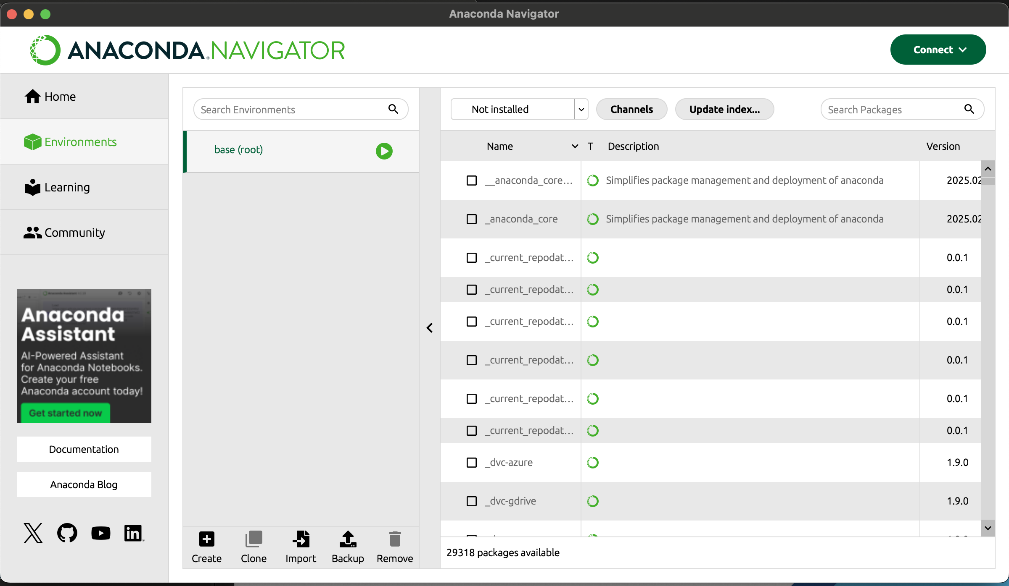
NAVIGATOR ENVIRONMENTS
In your main Navigator menu, select Environments. When you start, you will have only one environment. This is your base environment. Your Anaconda base environment has many libraries that are useful for data science. Ideally, you should not add anymore to your base environment.

Slide 31
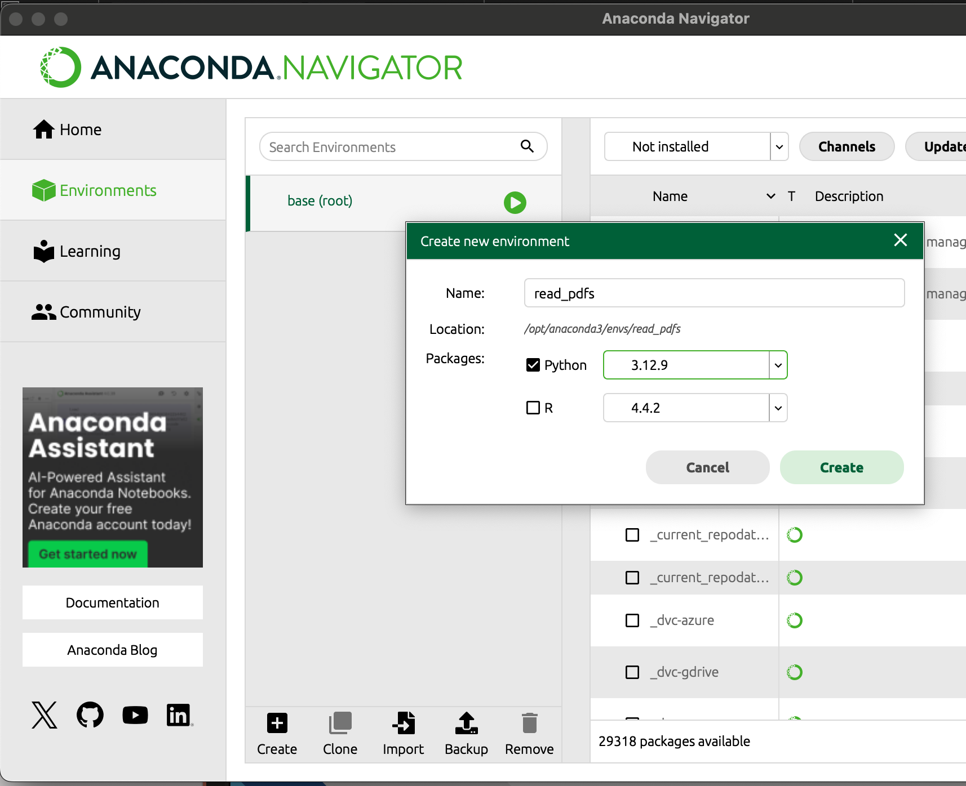
CREATING AN ENVIRONMENT
With Environments selected, click on Create at the bottom of the Navigator menu.
Name your environment. You may eventually have many Anaconda environments, so be sure to give your environment a name that clearly identifies its purpose or the project it is for.
If you wish, you can select earlier or later versions of Python to use.
In the Create new environment dialog, click Create to create the environment.

Slide 32
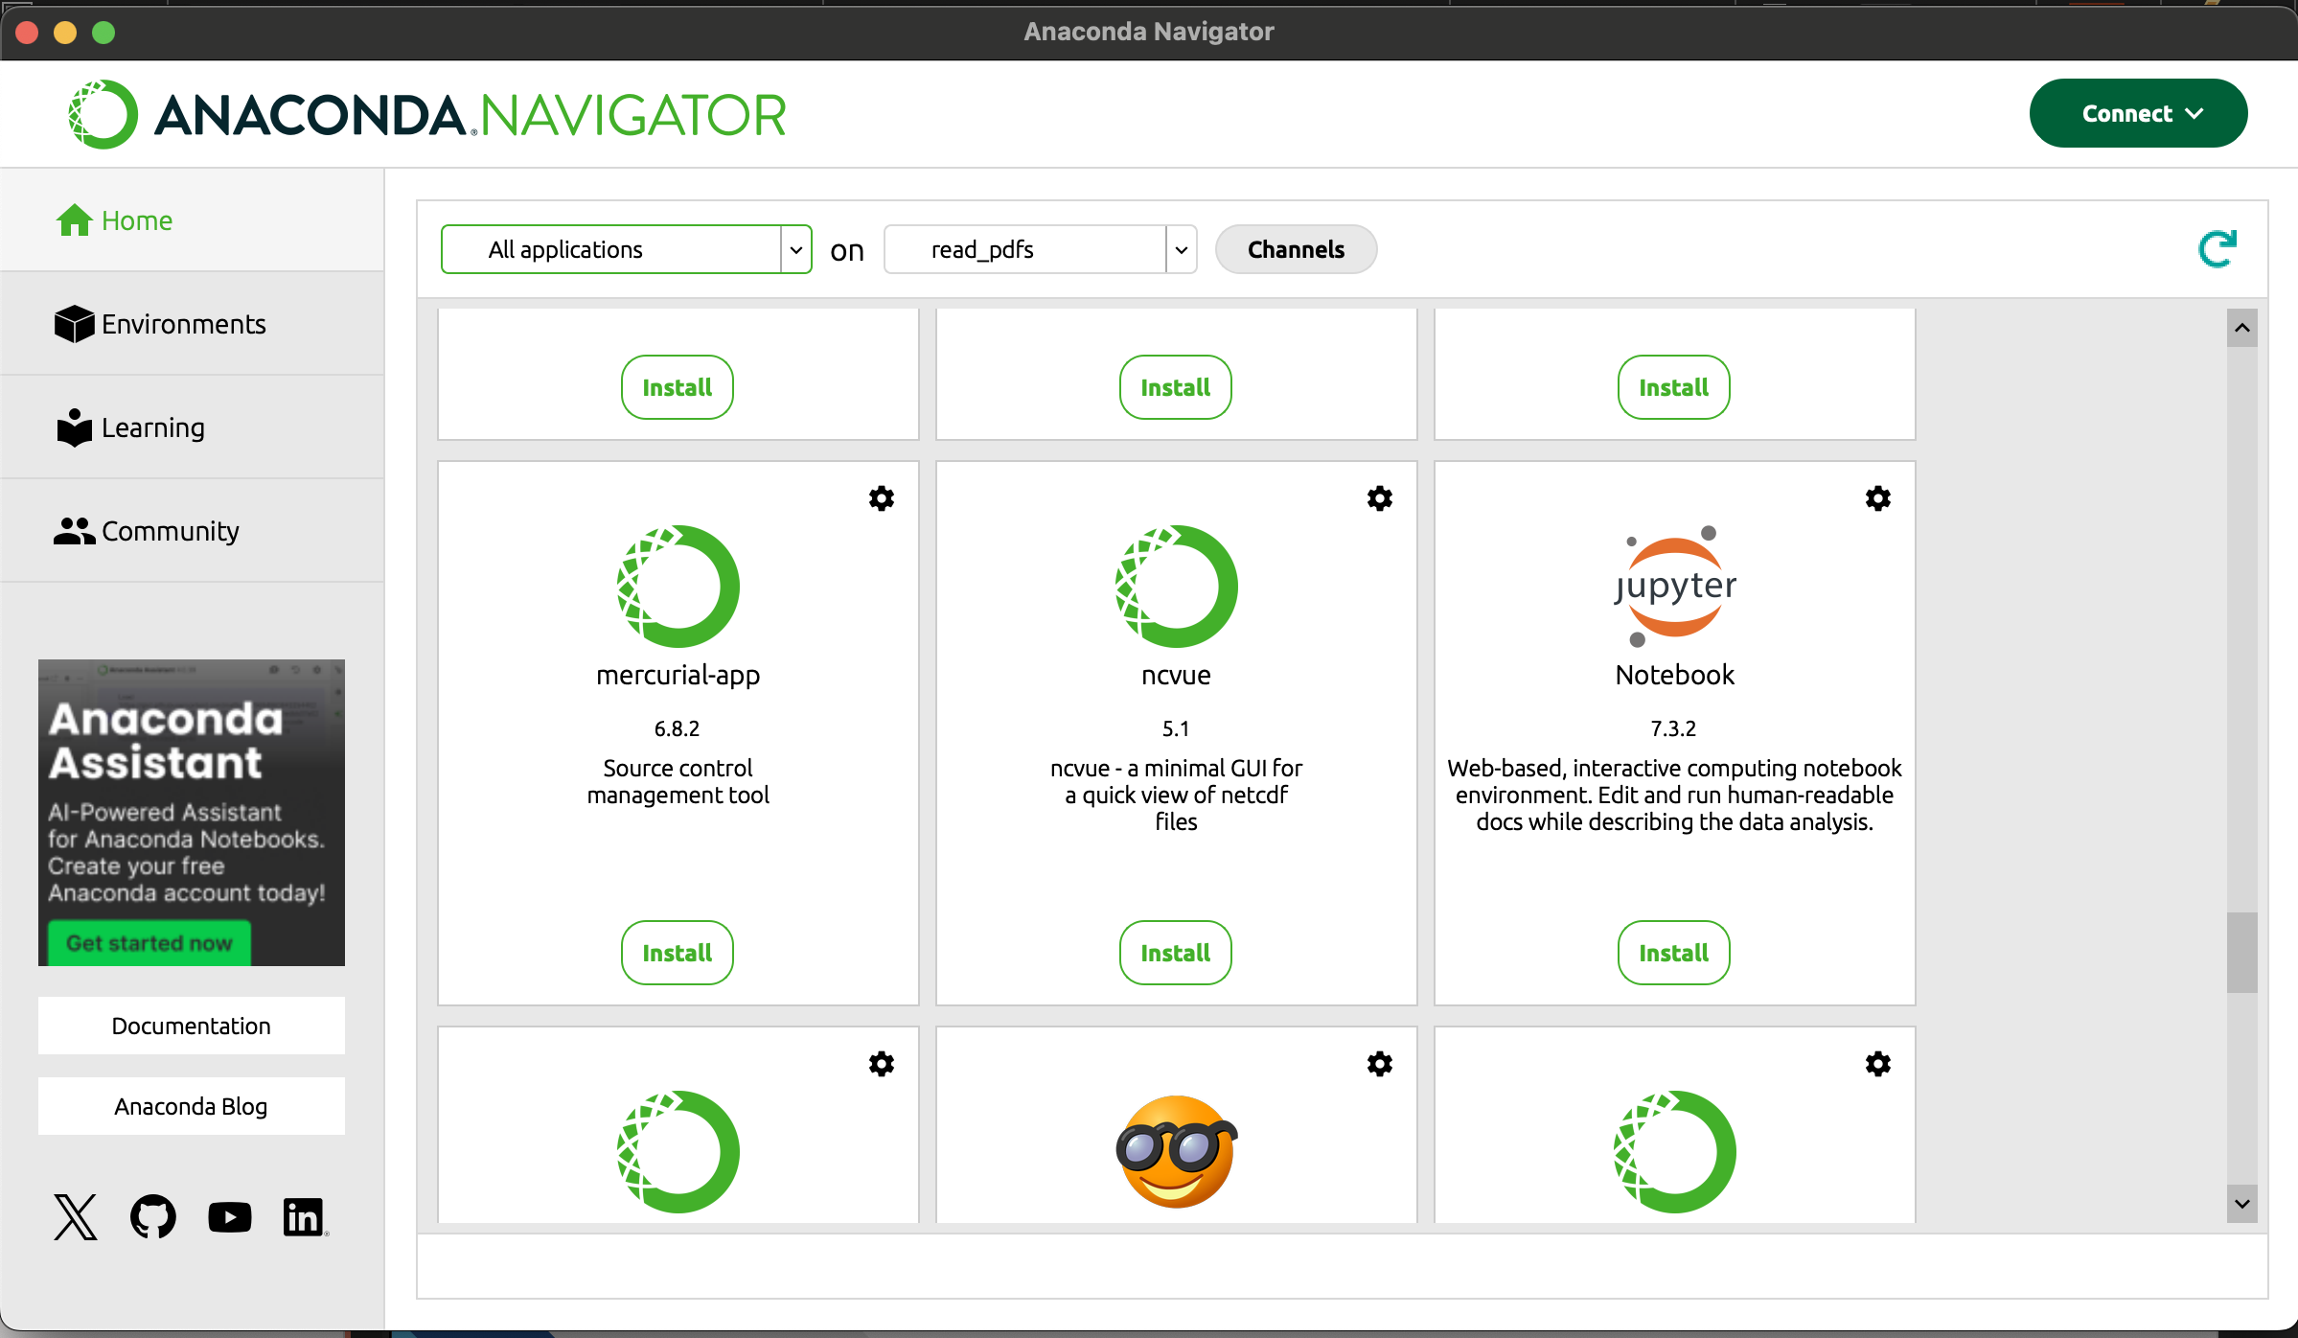
SELECTING AN ENVIRONMENT
In your Navigator menu, return to your Home pane.
Note that you can now select what environment to use from a dropdown.
Jupyter Notebook is actually a Python library. It is installed to your base environment, but not to this new environment you just created.
Scroll down until you see the Jupyter Notebook icon. Click Install to install it to this environment.

Slide 33
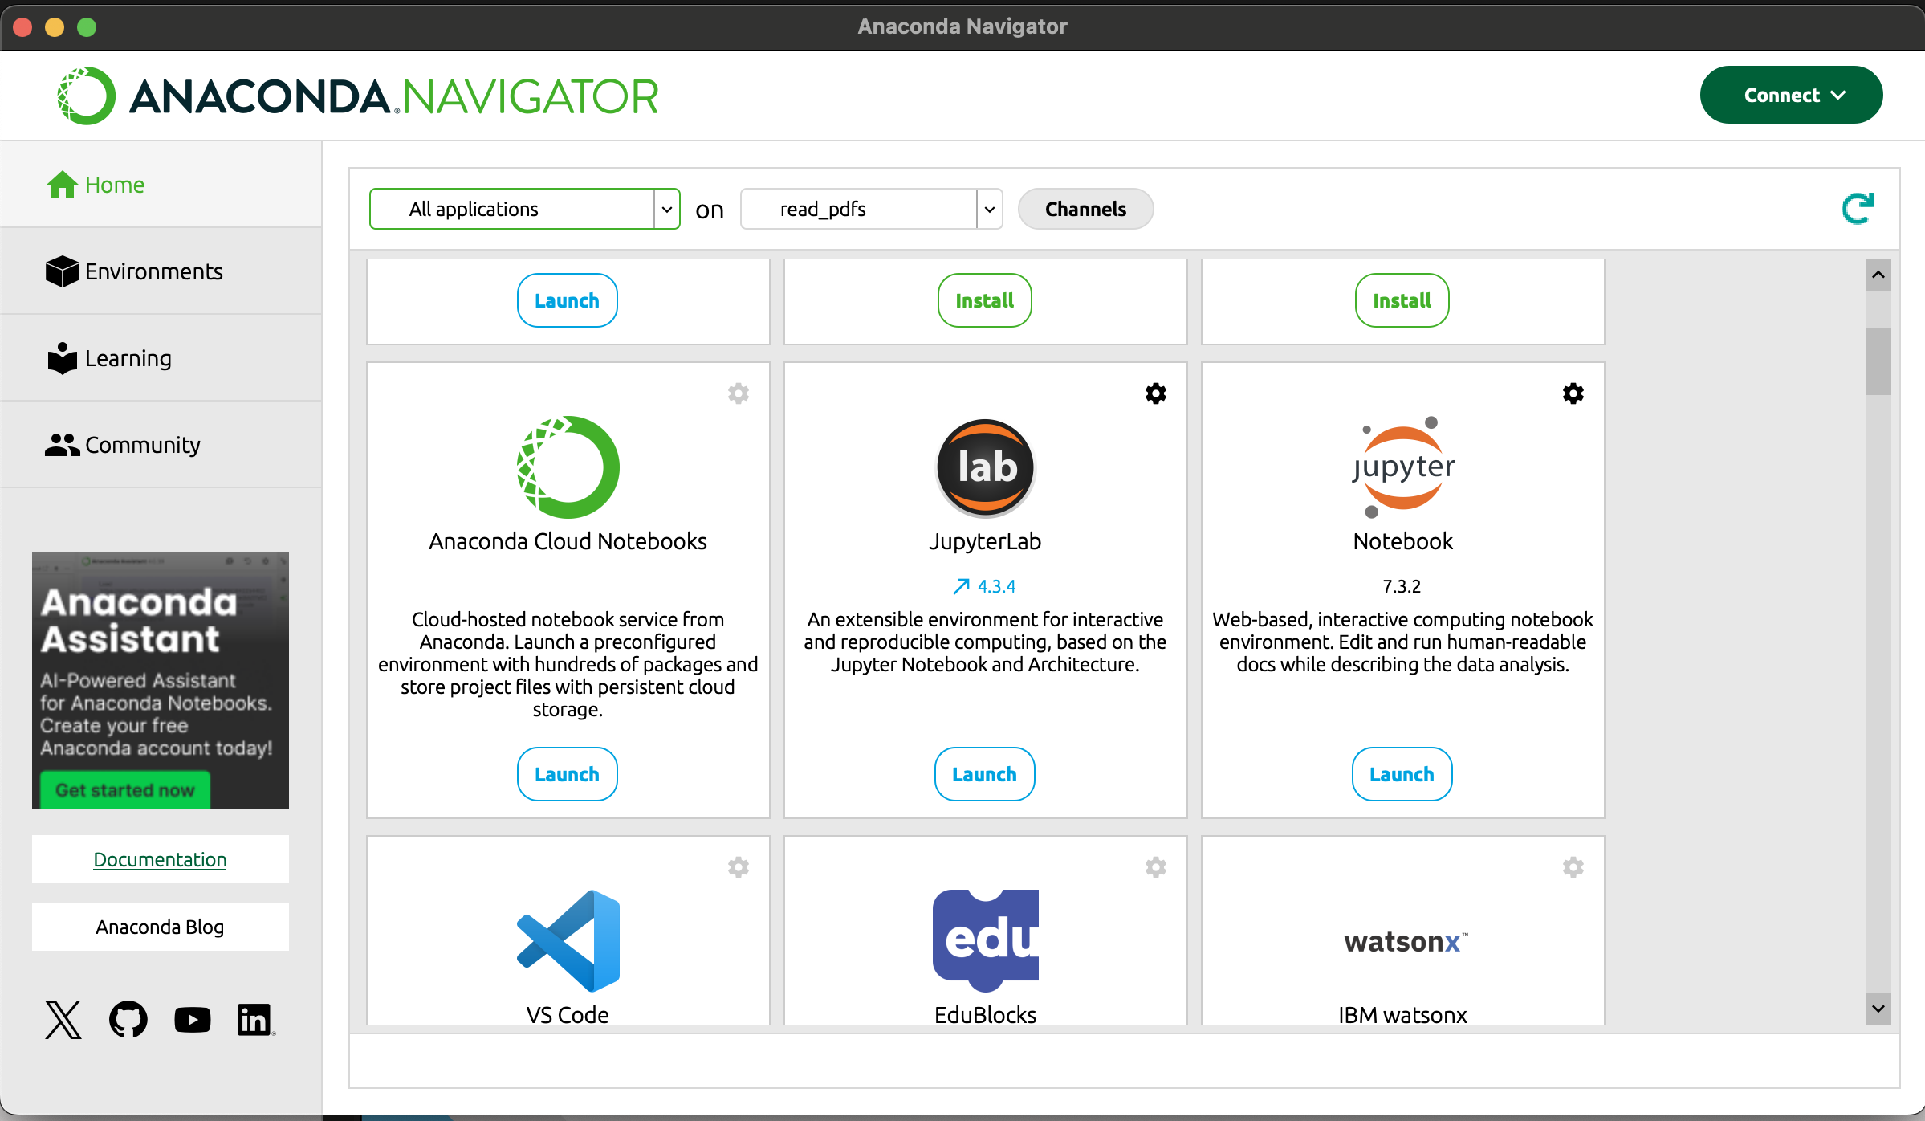
LAUNCHING A NOTEBOOK IN AN ENVIRONMENT
Now that Jupyter Notebook is installed to this environment, you can launch it.

Slide 34
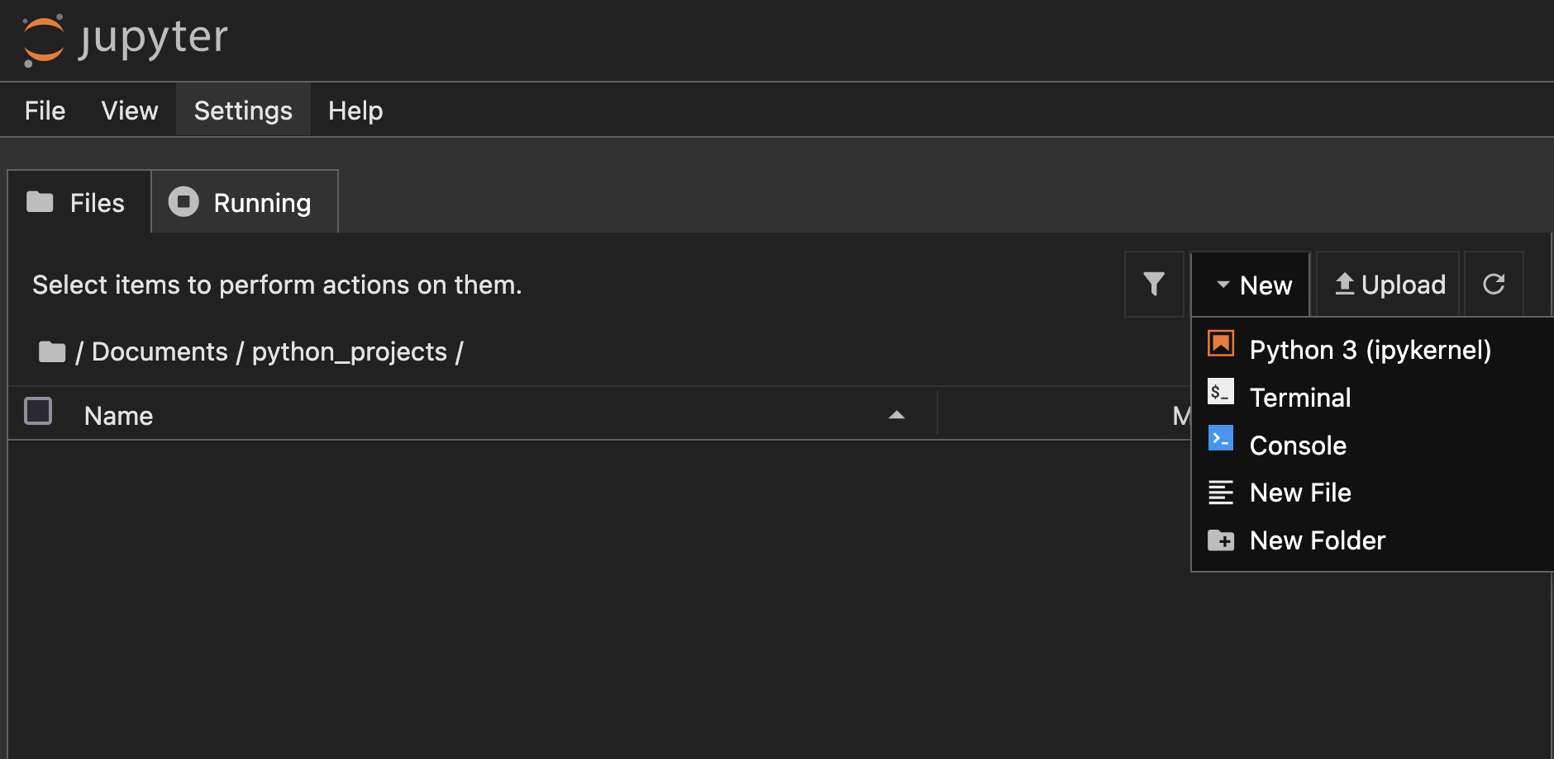
OPENING A NOTEBOOK IN AN ENVIRONMENT
Navigate to the folder where you want to keep your project and open a notebook.
When your notebook opens, remember to rename it from Untitled!

Slide 35
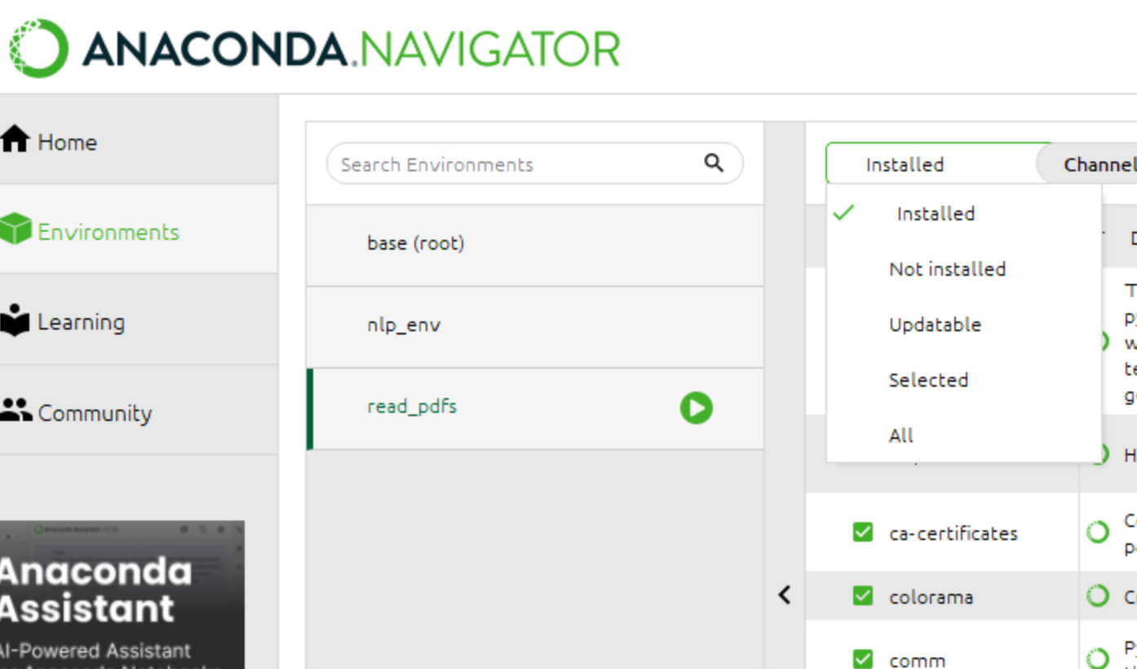
INSTALLING PACKAGES
Navigator has a graphical package installation interface. This queries a repository called the conda forge for packages.
When using Anaconda Navigator, it is preferable to use its internal tools to install libraries if possible.
Select “All” to search for all available packages.

Slide 36
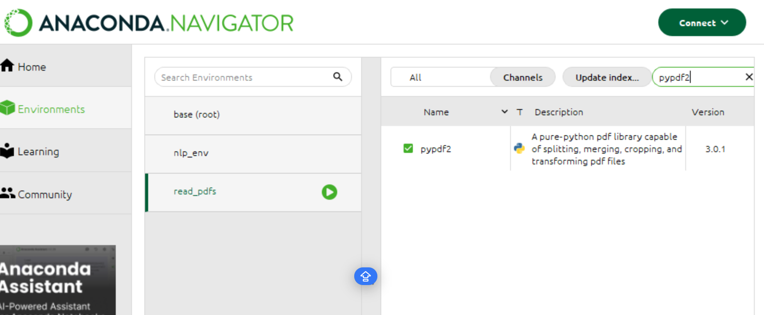
INSTALLING PACKAGES
Search for the package you are interested in.
Select it to install it to this environment.
If the library you are looking for is not available in the conda forge, then you can use pip install in your notebook instead.

Slide 37
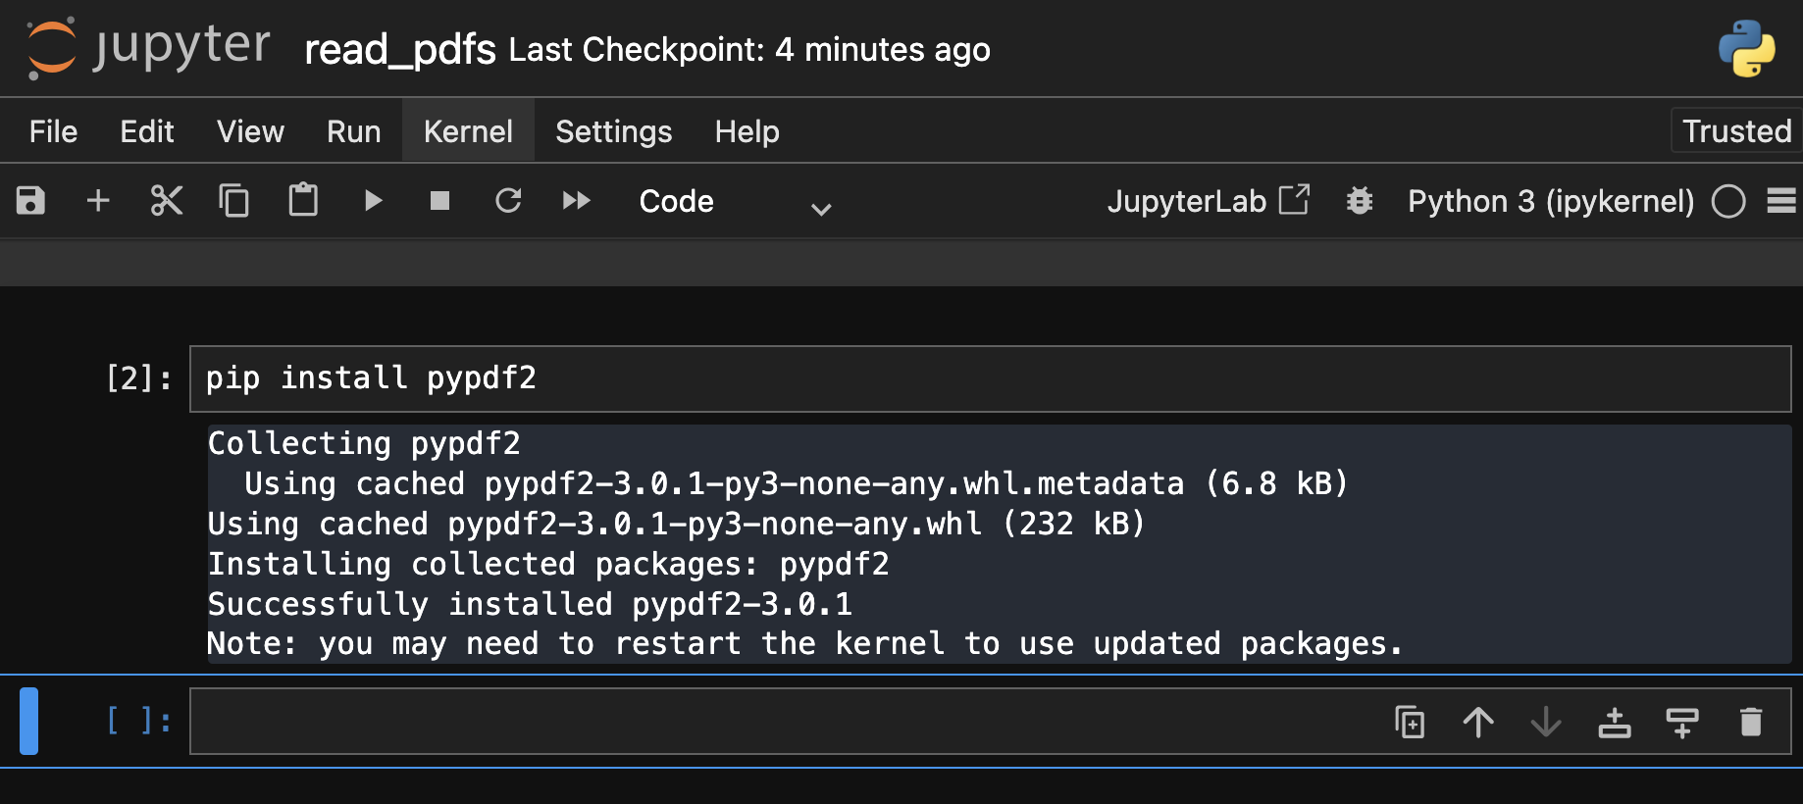
USING AN ENVIRONMENT
You are now ready to do pip install. Your packages and libraries will be installed to the environment you created and selected, not to your base environment.
When a library is not available in conda forge, use pip install. This queries the Python Package Index, a larger repository than the conda forge.

Slide 38

HOW DID WE DO?
Please take this short survey!

Slide 39
APPENDIX 1: VIRTUAL ENVIRONMENTS IN JUPYTER NOTEBOOKS
04

Slide 40
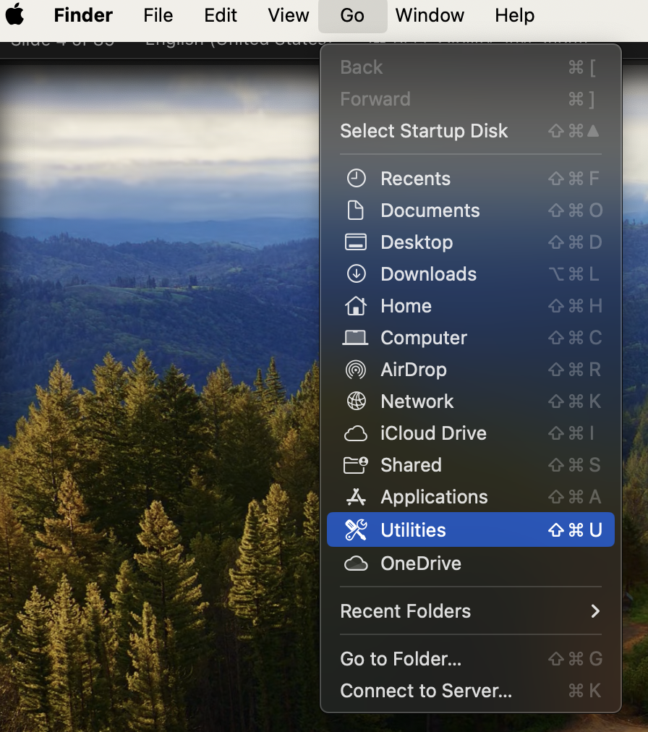
XCODE TOOLS
To use advanced environment management techniques, Mac users should have a package of tools called xcode installed. These are free.
To check if you already have xcode installed, do Go -> Utilities -> Terminal. Open the Terminal application.

Slide 41
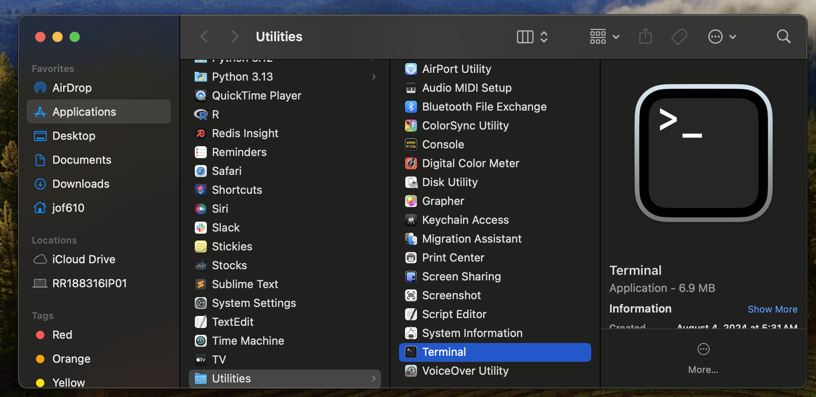
XCODE TOOLS

Slide 42
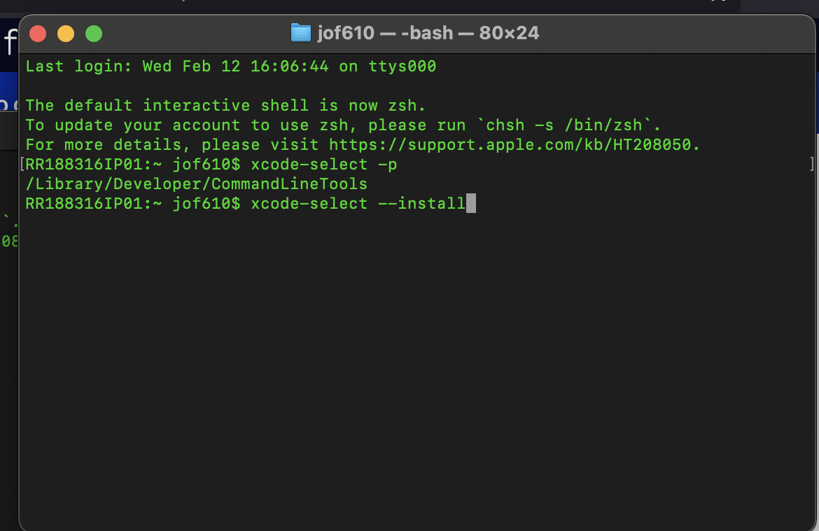
XCODE TOOLS
In your Terminal, type xcode-select –p
If you get a location, like /Library/Developer/CommandLineTools, then you already have xcode installed.
Otherwise, type xcode-select --install to install xcode tools while we proceed with the rest of the workshop.

Slide 43
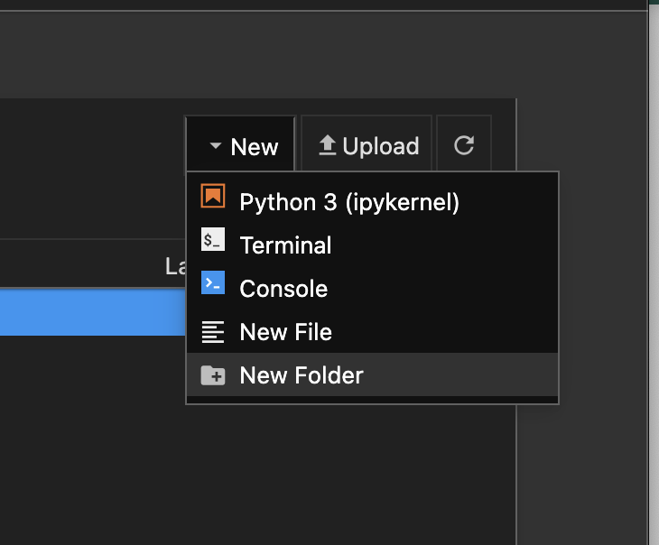
VIRTUAL ENVIRONMENTS IN JUPYTER NOTEBOOK
Let’s say I find a pdf and I want to convert it to a text file for text analysis. I might do a search for how to do this. I might find a page like this: https://www.delftstack.com/howto/python/pdf-to-text-python/
All the examples require me to pip install a library. Before doing this, I should create a virtual environment.
On a Mac, go back to the main Jupyter Notebook interface. Select New -> Terminal
A Terminal will open. This is a CLI (command line interface).

Slide 44
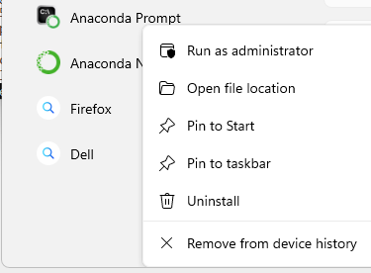
VIRTUAL ENVIRONMENTS IN JUPYTER NOTEBOOK
On a Windows system, use your Search Box to find the Anaconda Prompt. Right-click and select Run as administrator.

Slide 45
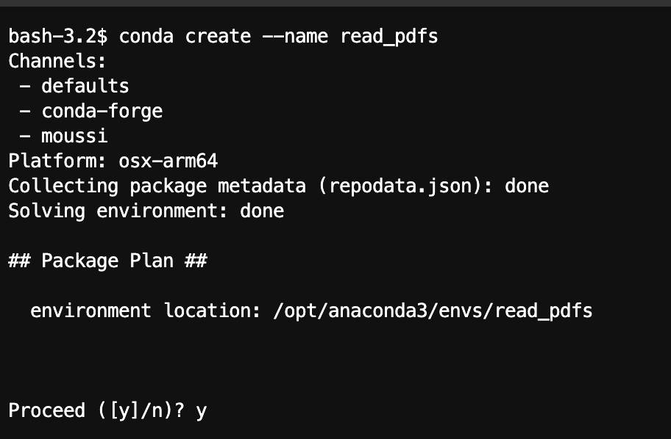
VIRTUAL ENVIRONMENTS IN JUPYTER NOTEBOOK:
In the terminal, type conda create --name and the name you want to give to your virtual environment. Be descriptive. Eventually you will have many of these and you will need to be able to remember which one was intended for what purpose.
This creates your virtual environment and places it in the anaconda directory. This is essentially a copy of Python.
Note the location of your anaconda base environment, in this case /opt/anaconda3. You can also get this information by typing conda info in a terminal.

Slide 46
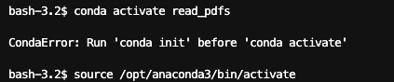
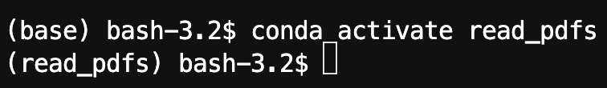
VIRTUAL ENVIRONMENTS IN JUPYTER NOTEBOOK
Once the environment has been created, I need to activate it. The command for this is conda activate name_of_env
On a Mac, if I get the error telling me to “run ‘conda init’”, I need to use the source command to tell the terminal where the activate code is located. It is in the anaconda code’s bin folder. In this configuration, I should run source /opt/anaconda3/bin/activate.
Now, I can run the command conda activate read_pdfs. My virtual environment is now activated.

Slide 47
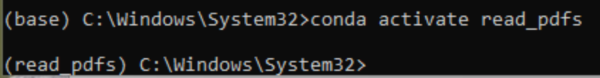
VIRTUAL ENVIRONMENTS IN JUPYTER NOTEBOOK
In the Windows Anaconda Prompt, the sourcing step should not be necessary.
Note that in both Windows (top) and Mac (bottom), the prompt should change to indicate the activated environment.

Slide 48
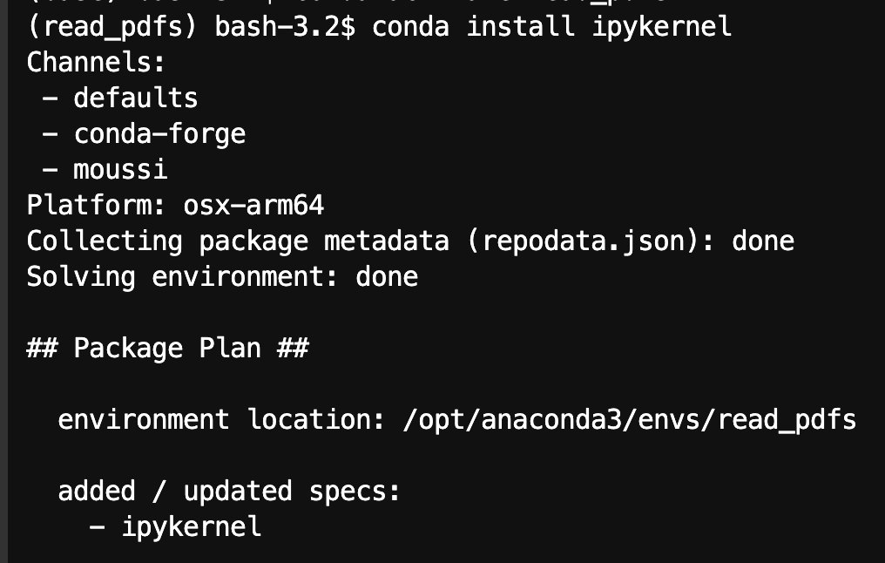
VIRTUAL ENVIRONMENTS IN JUPYTER NOTEBOOK
With this done, I need to install the ipykernel package. This installs a kernel in our environment. Remember, this is the Python interpreter that a Jupyter notebook uses.
It is important at this stage to use conda install to install this package.
Run conda install ipykernel and when asked if you want to proceed, say y.

Slide 49
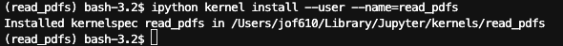
VIRTUAL ENVIRONMENTS IN JUPYTER NOTEBOOK
Now I can use the ipython command, which interacts with Jupyter’s Python interpreter, and configures the Notebook application to use the kernel we just created.
The command for this is ipython kernel install --user --name=name_of_env

Slide 50
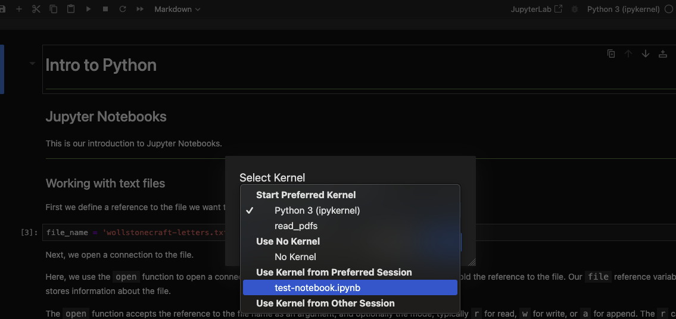
VIRTUAL ENVIRONMENTS IN JUPYTER NOTEBOOK
After refreshing my browser, on a Mac, I can now switch my notebook to use the read_pdfs virtual environment.

Slide 51
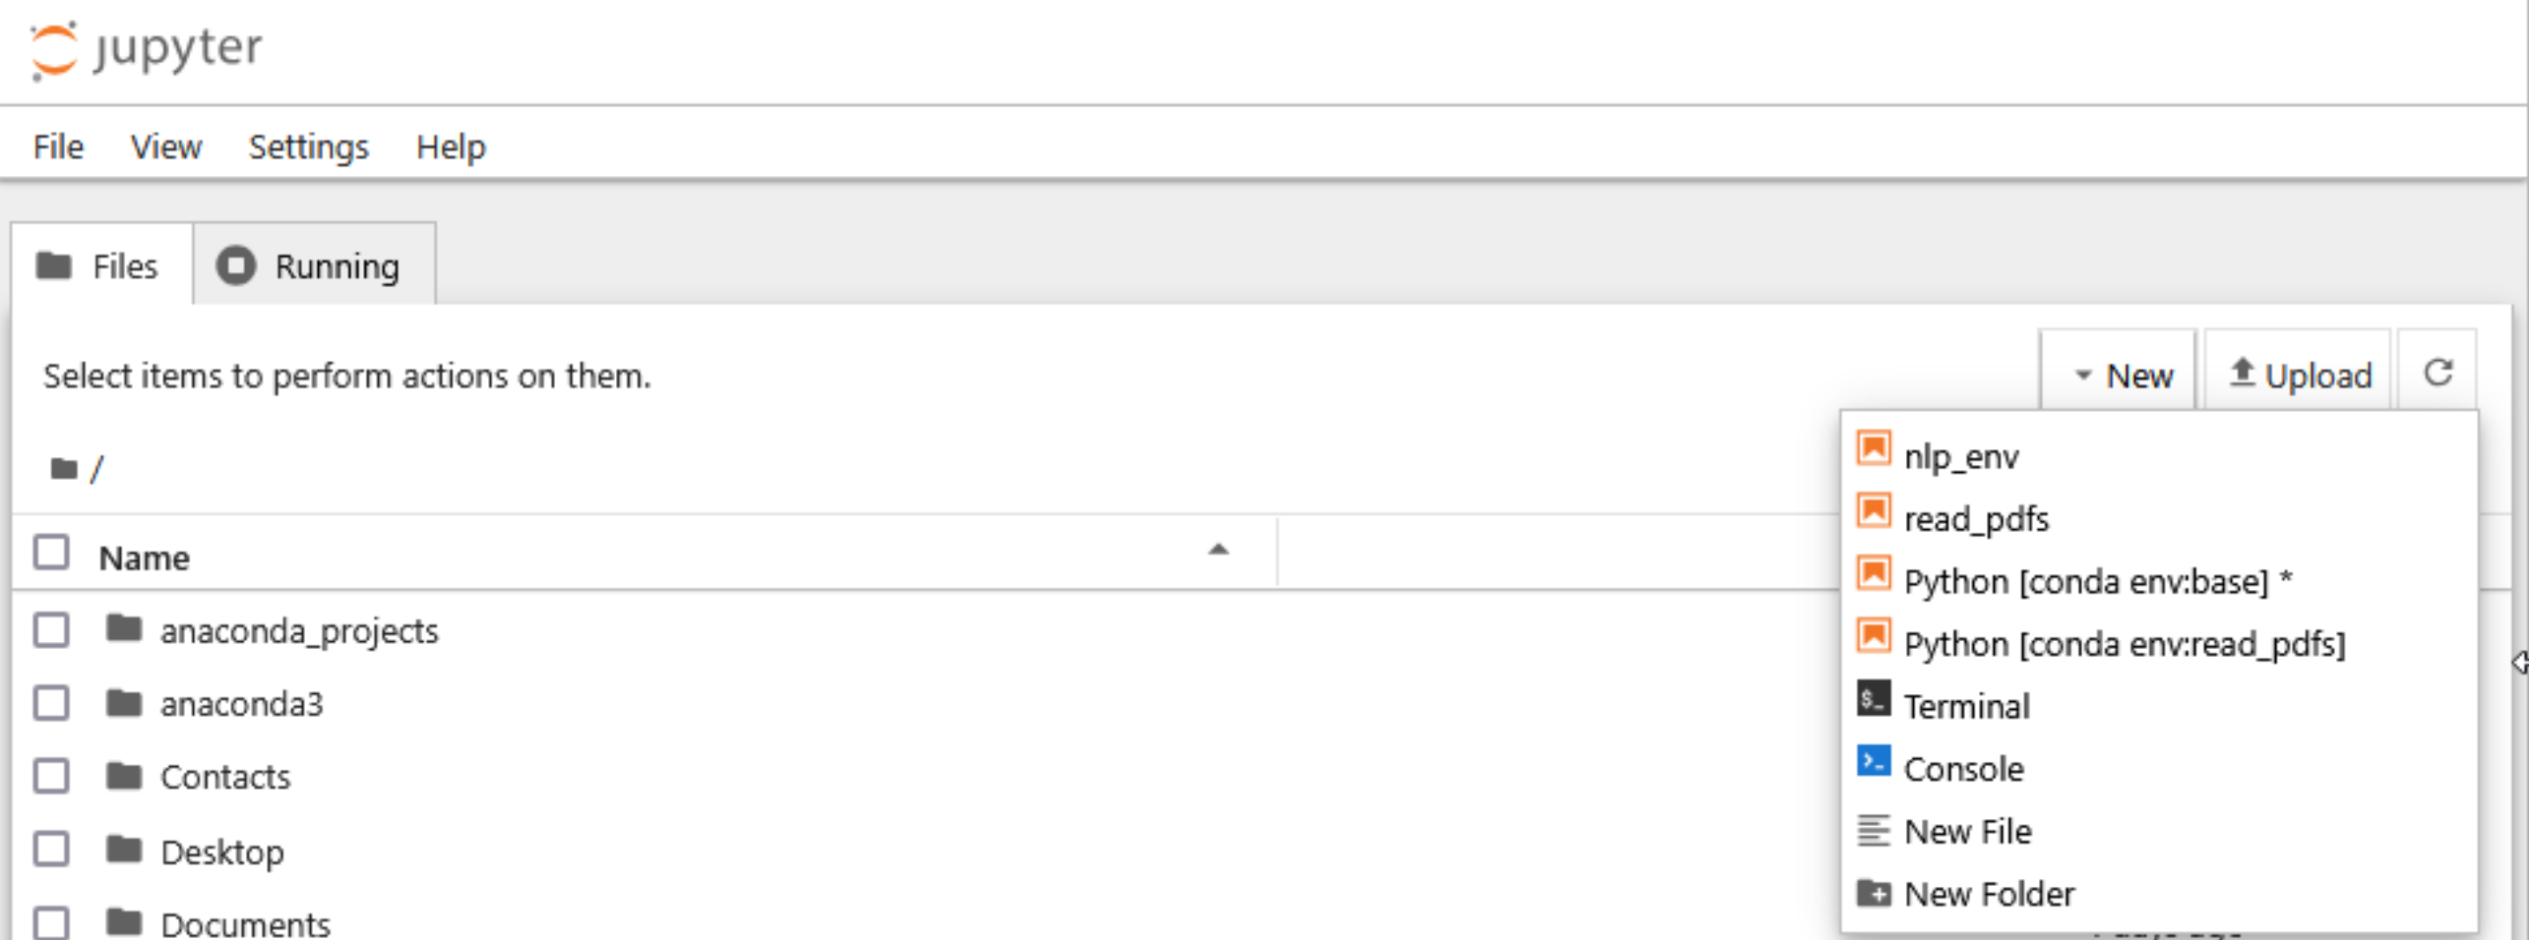
VIRTUAL ENVIRONMENTS IN JUPYTER NOTEBOOK
After refreshing my browser, Windows, I can now select conda env:read_pdfs or read_pdfs virtual environment. They both refer to the same environment, but conda env:read_pdfs reassures us that we are using the conda environment.

Slide 52
VIRTUAL ENVIRONMENTS IN JUPYTER NOTEBOOK
Let’s summarize the process for creating a virtual environment in Jupyter Notebooks.
Open the Terminal
Create the virtual environment.
Find the location of the anaconda base environment.
Tell your Terminal where to find the code to activate the virtual environment.
Activate the virtual environment.
Install the ipykernel environment.
Install the new kernel to your Jupyter kernels list.
Switch to the virtual environment in your notebook.

Slide 53
APPENDIX 2: VIRTUAL ENVIRONMENTS THROUGH THE CLI
05

Slide 54
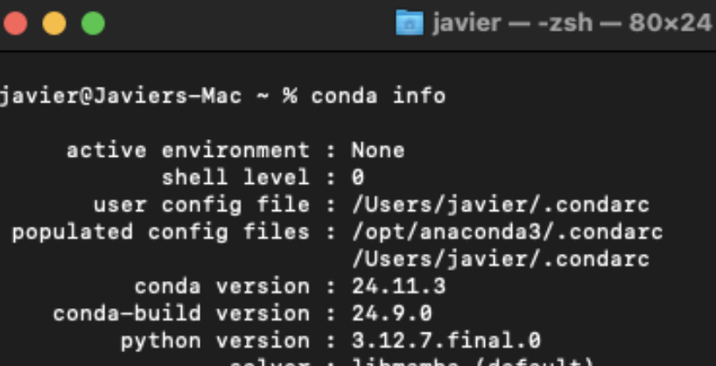
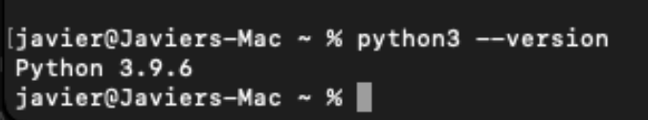
VIRTUAL ENVIRONMENTS FOR POWER USERS: MAC OS
On a Mac, if I installed Python by installing Anaconda Navigator, I can find out my Python version by opening a terminal and typing conda info.
I might also have Python installed on my system, separately from Anaconda. I can type python3 --version to check.
Depending on my particular Python installation history, I can also type echo $PATH to find out what versions I have installed.

Slide 55
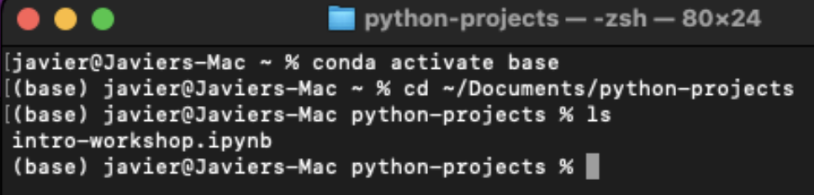
VIRTUAL ENVIRONMENTS FOR POWER USERS: MAC OS
To create a 3.12 virtual environment in this case, since 3.12 is only available through Anaconda, I have to activate my Anaconda base environment. I do this by entering conda activate base in my terminal.
Now I can create a virtual environment. Note that it will place the files in the location my terminal is currently pointed to. I should first navigate to the folder in which I want to store the environment files.

Slide 56
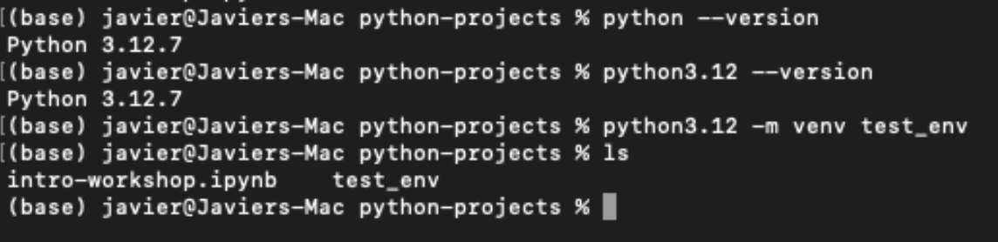
VIRTUAL ENVIRONMENTS FOR POWER USERS: MAC OS
First, I check to make sure that the version of Python I want to use is accessible at the command line. Then I issue my command. Following best practice, I am specific about the version of Python I want to use. I say python3.12 -m venv test_env. This means “Use python 3.12, use the module (-m) called ”venv” (virtual environment module) to create a virtual environment called “test_env”.

Slide 57
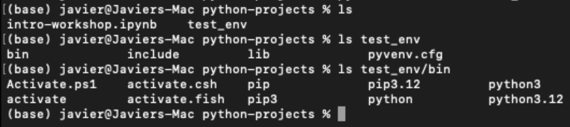
VIRTUAL ENVIRONMENTS FOR POWER USERS: MAC OS
Notice I now have a directory called “test_env” in my python-projects folder. Inside test_env is a directory called bin, and inside bin is a file called activate.

Slide 58
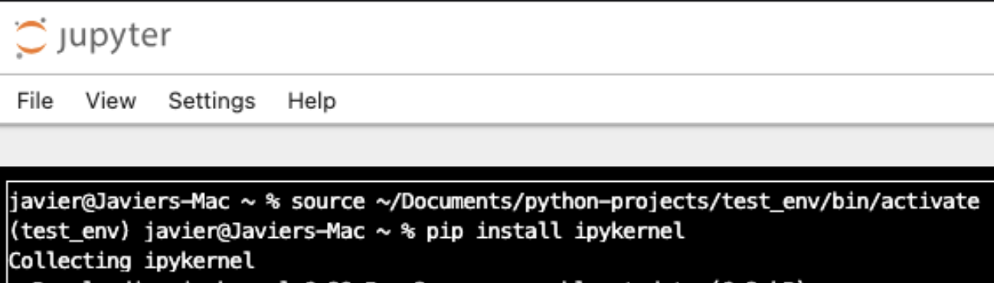
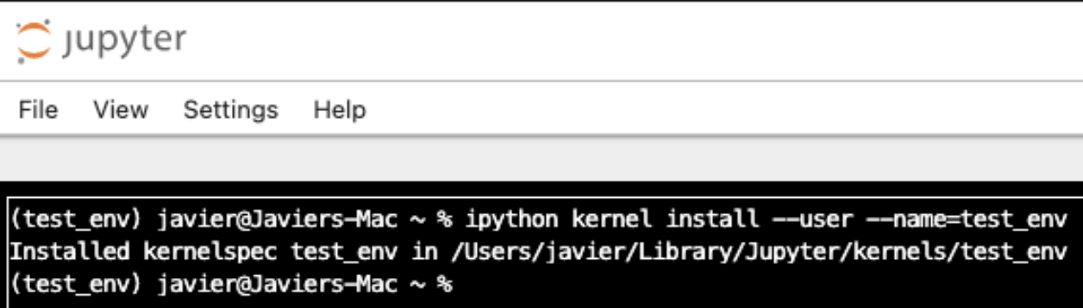
VIRTUAL ENVIRONMENTS FOR POWER USERS: MAC OS
Now I can follow the procedure explained earlier for using a virtual environment with Jupyter Notebook.
Activate the environment by using the source command and giving it the path to the virtual environment’s activate file.
Then pip install ipykernel and use ipython to install a new kernel. Refresh your notebook browser window and you should see the new environment available in the dropdown.

Slide 59
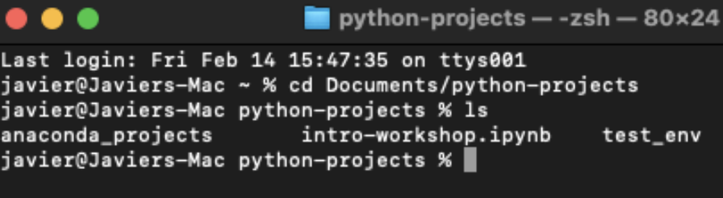
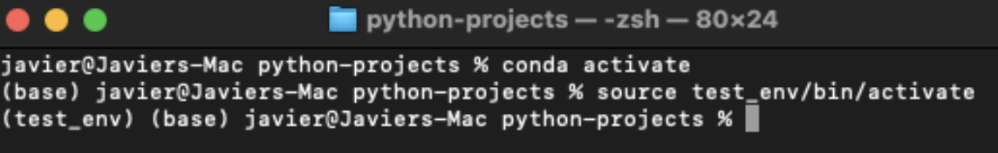
VIRTUAL ENVIRONMENTS FOR POWER USERS: MAC OS
Though it is convenient, I don’t need to install my virtual environment to my Jupyter interface. I can activate my environment and then activate Jupyter within that environment.
First, navigate to the directory where you want to store your notebook files and other project files.
Then, activate your Anaconda base environment. Then, activate your virtual environment.

Slide 60
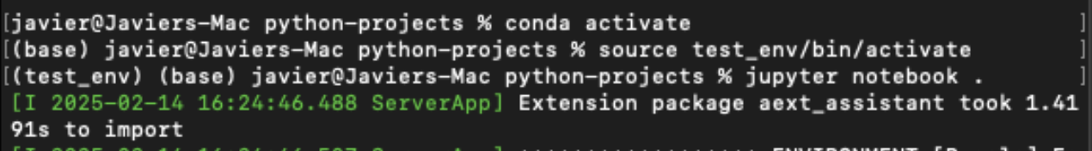
VIRTUAL ENVIRONMENTS FOR POWER USERS: MAC OS
Now, I can open a notebook through my terminal. I type jupyter notebook .
The dot after ”juptyer notebook” means “here” or “in this directory I’m in”. In this case, my “python-projects” directory.
Since I have my virtual environment activated, within the conda base environment, any packages I install will be installed within that environment, not within my base environment.
Note that this will only work if the Jupyter package is installed within the environment. In this case, Jupyter is already part of the conda base environment, so it gets carried over to test_env. Otherwise, I would have to first do pip install notebook or pip install jupyter.

Slide 61
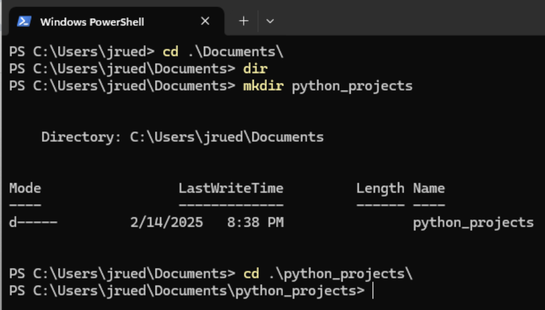
VIRTUAL ENVIRONMENTS FOR POWER USERS: WINDOWS
In Windows, the process for creating a virtual environment also begins with creating the directory in which you will store your environment, which should also be where you will run your code and store your notebooks.
Here, I change directory (cd) into my Documents folder. I use dir to list out what is in there, but it is empty. I use mkdir (make directory) to create a python_projects directory. Then I use cd again to move into that directory.

Slide 62
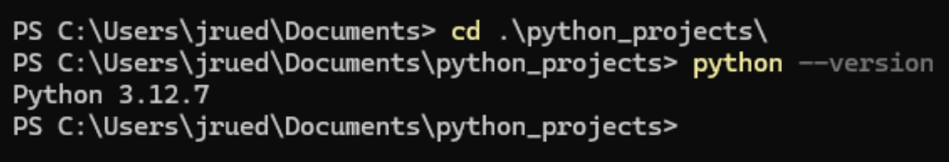
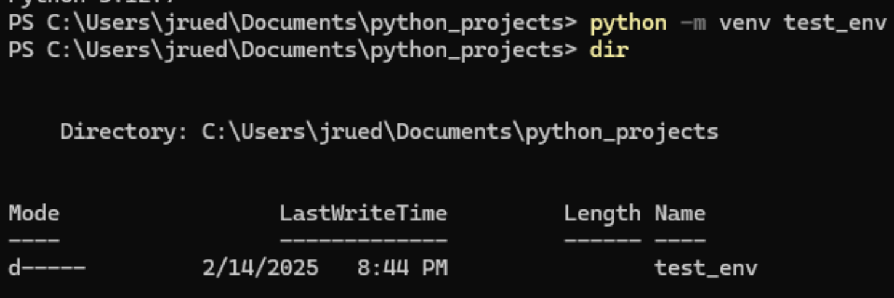
VIRTUAL ENVIRONMENTS FOR POWER USERS: WINDOWS
Now I check to make sure what version of Python I have installed by default. In this system, I only have the version that was installed with Anaconda Navigator, and that is version 3.12.7. When I run the python command, this is the version that will be used.
I now tell Python to use the venv module to create a virtual environment called “test_env”. This will copy Python 3.12 into a new directory called test_env.

Slide 63
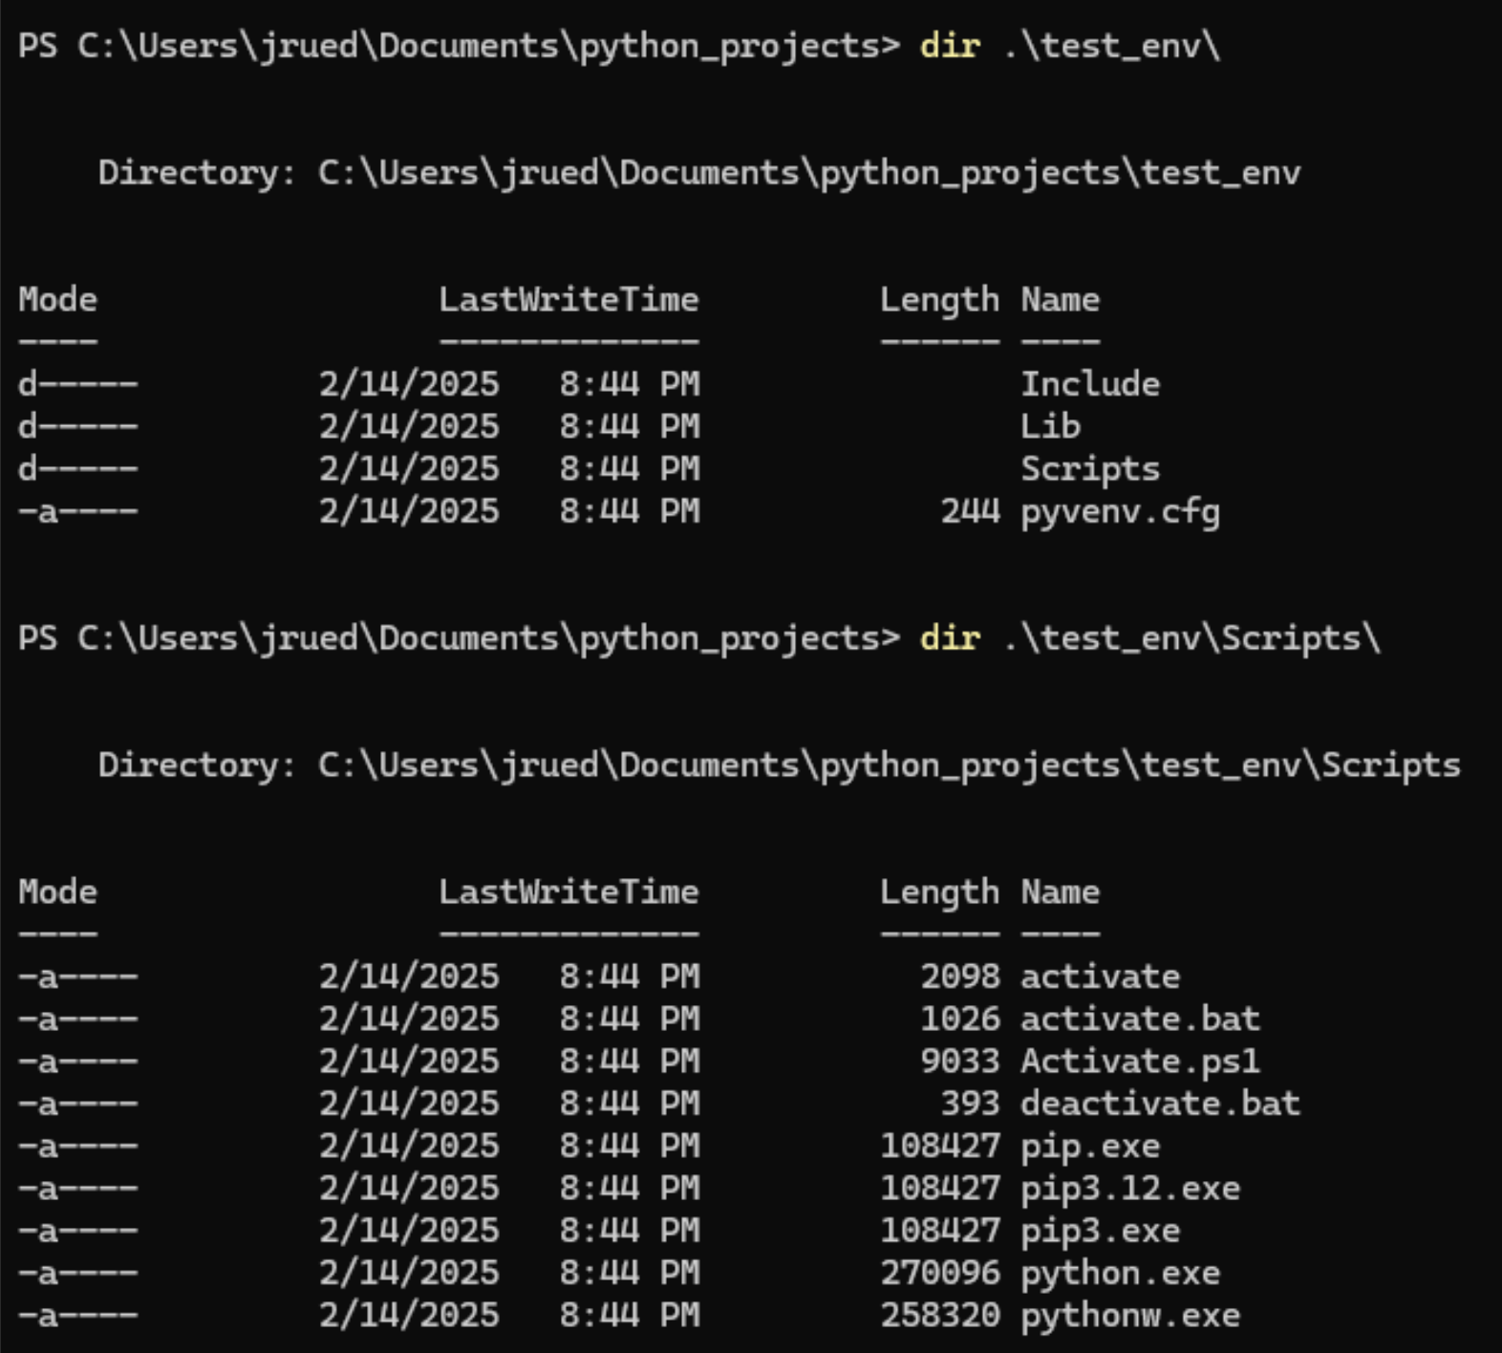
VIRTUAL ENVIRONMENTS FOR POWER USERS: WINDOWS
Now, if I peek into my “test_env” directory, I will see that there is a “Scripts” subdirectory, and if I look in there, I will see an “activate” script and a “activate.bat” script. These are the scripts I can use to activate my virtual environment.

Slide 64

VIRTUAL ENVIRONMENTS FOR POWER USERS: WINDOWS
To activate the virtual environment, you have to run the activate script, but you may find that your shell is set to prevent scripts from running.

Slide 65

VIRTUAL ENVIRONMENTS FOR POWER USERS: WINDOWS
If you must change the script execution policy in your Windows shell, first start a new shell with Run as administrator.

Slide 66

VIRTUAL ENVIRONMENTS FOR POWER USERS: WINDOWS
Now, change into your python projects directory. Check your current script execution policy. Change the execution policy to “RemoteSigned”, which is a little more secure than “Unrestricted”.

Slide 67

VIRTUAL ENVIRONMENTS FOR POWER USERS: WINDOWS
Now, you can run your activate script to activate your virtual environment. Note that the prompt changes to include (test_env). Since I am using the version of Python that was bundled into my Anaconda Navigator, Jupyter Notebook is included already. I can type jupyter notebook . at the prompt and a notebook will open. The period means “open it here, in this directory”. A browser window will open with a notebook that is running my virtual environment.

Slide 68
APPENDIX 3: INSTALLING MULTIPLE VERSIONS OF PYTHON
06

Slide 69

Eventually you will want to have multiple versions of Python on your system, and you will want to manage them personally rather than relying on Anaconda.
The central repository for older Python versions is python.org’s downloads page:
https://www.python.org/downloads/
Find and select your operating system at the top of the page.

Slide 70

In Mac OS, it is simplest to install a version of Python that has an available “universal installer”. Versions without the universal installer need to be installed through the command line, whereas the installer offers a graphical interface for Python installation.
The following slides are for Mac OS. Windows will be covered afterwards.

Slide 71

Once you’ve downloaded the installer, double click on the .pkg file to start the installation process.

Slide 72

Once the installation process is complete, you will see the version listed in your Applications folder.

Slide 73

I can now check my $PATH variable. This is a file that my terminal consults when I issue command line commands. It looks in this file to find the programs that correspond to my commands. The location of the Python 3.10 executable files are now listed in my $PATH. Notice that when I use python3 or python3.10 the terminal will now use the version I just downloaded.
This version is a clean, basic Python install without any of the bundled libraries that come with Anaconda. It is separate from your Anaconda install.

Slide 74

You can install SSL certificates by double-clicking “Install Certificates” in your Python application folder. This helps ensure security when Python connects to the Internet, for example when downloading packages.

Slide 75

Notice here I have created a new folder called ”my_dh_python_project” , aimed at containing my new digital humanities project. I then navigate to that directory in my terminal. Then, I invoke python3.10 specifically, and create a virtual environment called “dh_project”.
Since the virtual environment files are stored in the same folder as my python project, I will never be in any doubt as to which virtual environment I was using with this particular project.

Slide 76


Since this is a clean Python install, Jupyter Notebook is not included at first. Here, I activate my virtual environment by using source and the location of the activate script. But when I try to start a notebook, the terminal does not recognize the jupyter command. So, the first package I install is notebook. After the notebook package is done installing, I can open a notebook in my virtual environment.

Slide 77

On Windows, go to python.org/downloads/windows. Select the version of Python you want to install.

Slide 78

We will use the regular “Install Now” prompt as we do not need to customize the location and features.
At this time, do not add python.exe to PATH. Windows comes with a utility program called the Python Launcher that we can use to manage different versions of Python, so we do not need to deal with the PATH environment variable for this purpose.

Slide 79

When our installation is done, we can open a PowerShell. The command py --version tells us our default Python version. This is still 3.12.7, the version that was installed with Anaconda Navigator. But, if I type py --list, I will see all the version of Python on my system. Now I can see that I also have 3.10 installed. I can also check the specific version of Python 3.10 that I have installed.

Slide 80

I will navigate to my Python projects directory, then I will create a new directory for my new digital humanities project. Then I will navigate into that directory.
I am going to create my virtual environment in the same folder as my project. This way I will always know what virtual environment I am supposed to run with this particular project.

Slide 81

Now I can use my Python Launcher to specify version 3.10 and call on the venv module to create a virtual environment called dh_project.
After creating the environment, I note that there is a dh_project directory. It contains a Scripts folder.

Slide 82

Inside the Scripts folder is an activate script.
To activate my virtual environment, I run this script. Note that the prompt changes to let me know the environment is activated. I can now install Jupyter Notebook to this environment.

Slide 83

At this point I can run my notebook with the command jupyter notebook .
However, it is common in Windows systems for notebook to fail to start due to an error in file permissions. You will see in the command line output that permission was denied, and a location such as C:\Users\username\AppData\Roaming\jupyter\runtime\jpserver-1234-open.html.
Copy this path -- starting only from the drive letter C: and ignoring anything before that such as file://
Open a Windows File Explorer and paste in this path.

Slide 84


Select the jupyter folder. Right click on the runtime folder. Select Properties -> Security. Click Edit to change permissions.

Slide 85

Select Everyone and then click Allow Full control and OK. If you get any error warnings just click Continue.

Slide 86

Full permissions for everyone on the Roaming\jupyter\runtime folder are now set.
Click on Advanced.

Slide 87

Click on Enable inheritance. Click Apply and if you get any errors, click Continue.

Slide 88

You might need to restart your PowerShell. You can now activate your virtual environment and start Jupyter Notebook within your virtual environment. Permission will no longer be denied and your notebook will open normally.

